Slide 1


Domestic Private Sector Workload Estimate
FY25 - FY28 Workload as of 01 DEC 2024
Industry Version FY25 Q1 M3
“Intent of this information is to provide U.S. DoD industry contractors a general schedule for information and planning purposes for upcoming surface ship maintenance periods- It does not constitute any request for information or request for proposals or any commitment to contract for work in accordance with this plan. This information is to assist U.S. DoD industry contractors by providing a broad overview of frequently changing (driven by U.S. Navy operations) maintenance schedules and is not a guarantee of workload or exact ship schedules”
“Distribution Statement A: Approved for Public Release; Distribution is unlimited.”

Slide 2
Notes
Data contained in this report reflects the Navy program of record as of 01 DECEMBER 2024.
The next bi-monthly workload projections are targeted for release no later than 28 FEBRUARY 2025.
Fleet Scheduling Conference was held in September 2024. Approved changes are in the process of being incorporated into the scheduling program of record
Industry manning impacts, results of ongoing availability duration and schedule review, tailored acquisition strategies and ongoing budget negotiations may refine out-year projections.
“Intent of this information is to provide U.S. DoD industry contractors a general schedule for information and planning purposes for upcoming surface ship maintenance periods- It does not constitute any request for information or request for proposals or any commitment to contract for work in accordance with this plan. This information is to assist U.S. DoD industry contractors by providing a broad overview of frequently changing (driven by U.S. Navy operations) maintenance schedules and is not a guarantee of workload or exact ship schedules”
“Distribution Statement A: Approved for Public Release; Distribution is unlimited.”

Slide 3
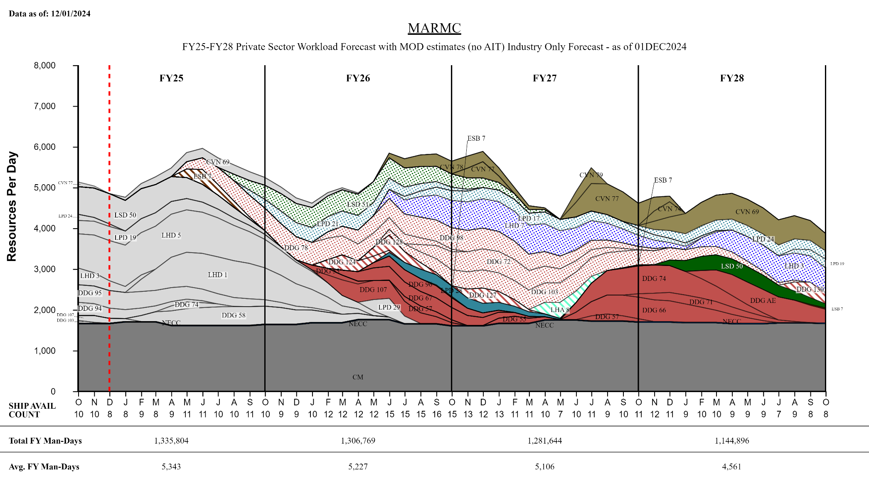
MARMC Private Sector
TIME NOW
“Intent of this information is to provide U.S. DoD industry contractors a general schedule for information and planning purposes for upcoming surface ship maintenance periods- It does not constitute any request for information or request for proposals or any commitment to contract for work in accordance with this plan. This information is to assist U.S. DoD industry contractors by providing a broad overview of frequently changing (driven by U.S. Navy operations) maintenance schedules and is not a guarantee of workload or exact ship schedules”
“Distribution Statement A: Approved for Public Release; Distribution is unlimited.”

Slide 4
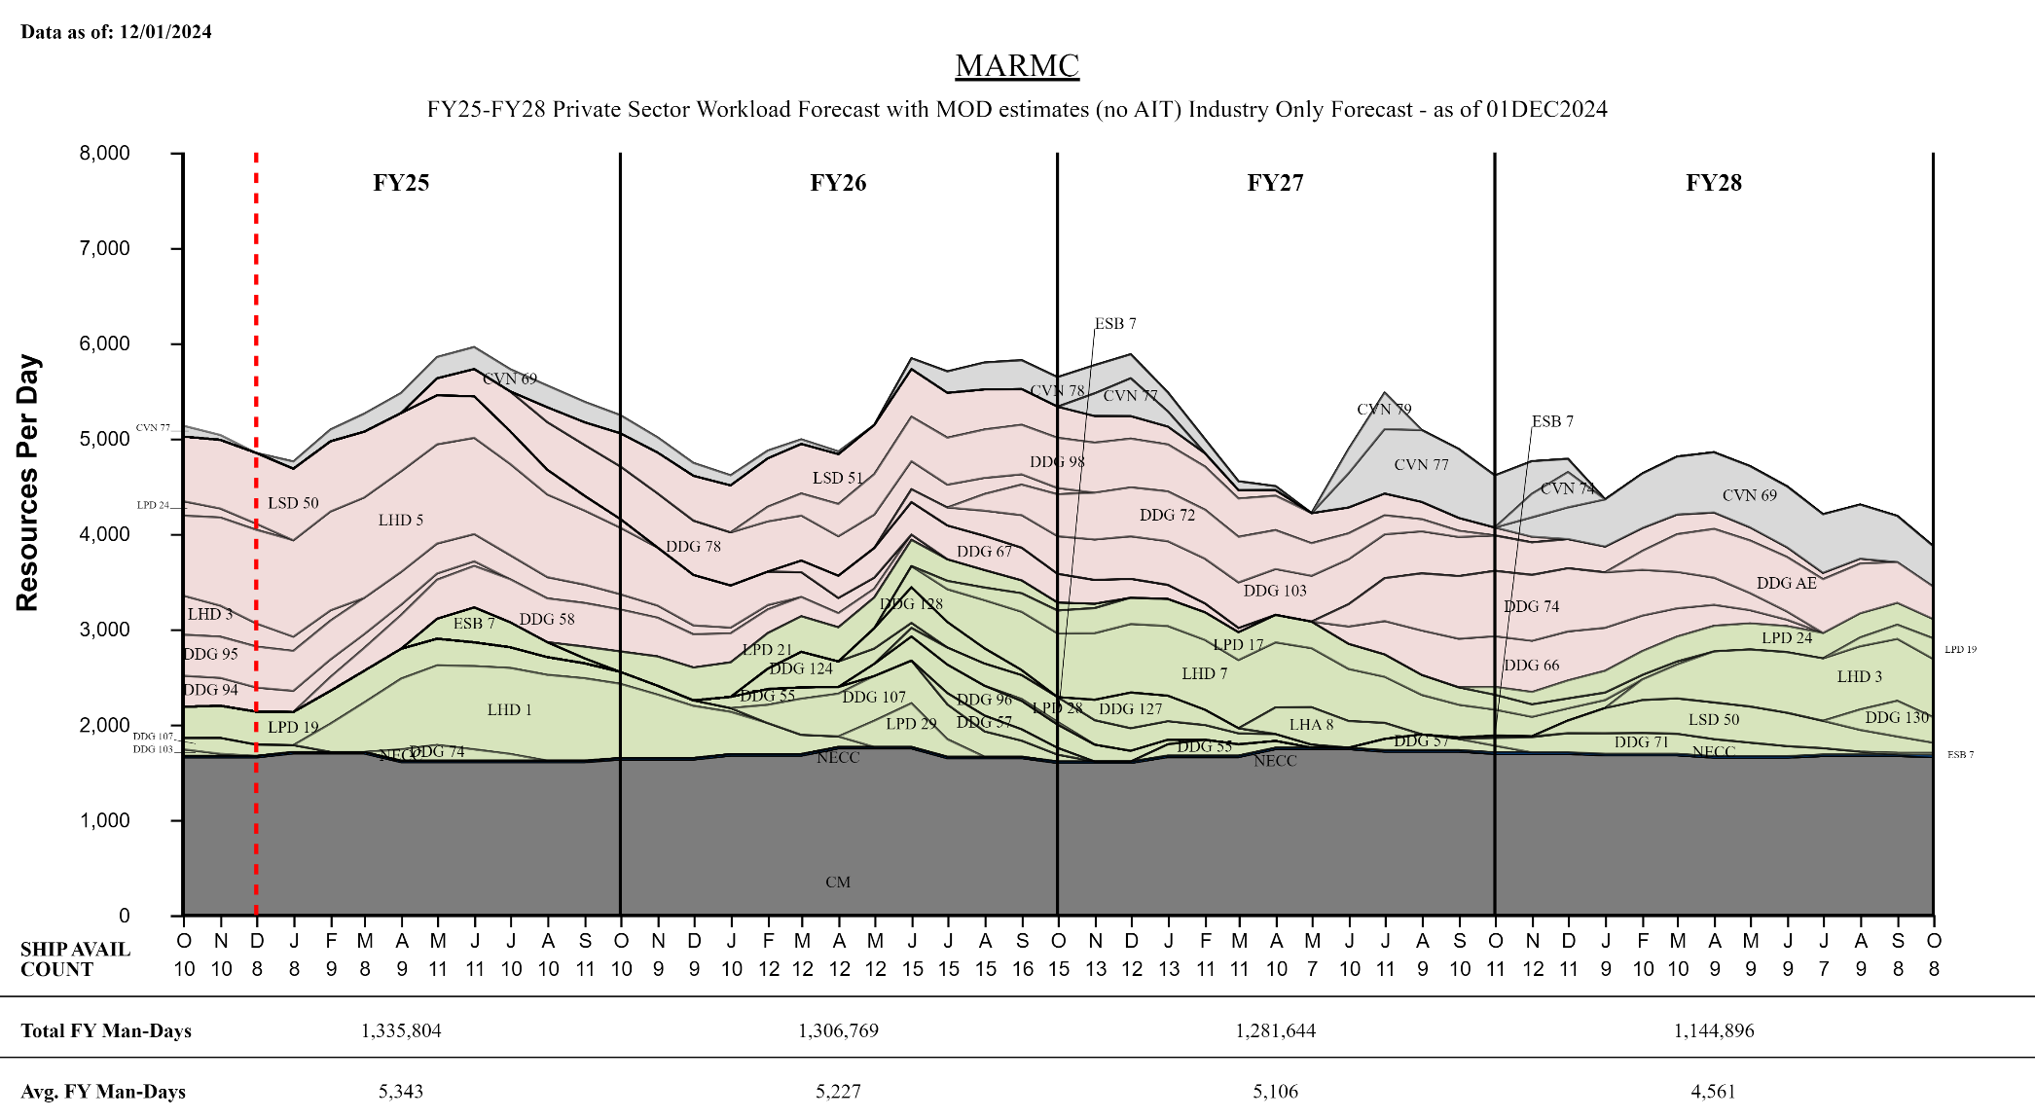
MARMC Private Sector
TIME NOW
“Intent of this information is to provide U.S. DoD industry contractors a general schedule for information and planning purposes for upcoming surface ship maintenance periods- It does not constitute any request for information or request for proposals or any commitment to contract for work in accordance with this plan. This information is to assist U.S. DoD industry contractors by providing a broad overview of frequently changing (driven by U.S. Navy operations) maintenance schedules and is not a guarantee of workload or exact ship schedules”
“Distribution Statement A: Approved for Public Release; Distribution is unlimited.”

Slide 5
MARMC Private Sector
Workload Forecast with MOD estimates (no AIT) FY25 - FY26
Industry Forecast - as of 01 DEC 2024
“Intent of this information is to provide U.S. DoD industry contractors a general schedule for information and planning purposes for upcoming surface ship maintenance periods- It does not constitute any request for information or request for proposals or any commitment to contract for work in accordance with this plan. This information is to assist U.S. DoD industry contractors by providing a broad overview of frequently changing (driven by U.S. Navy operations) maintenance schedules and is not a guarantee of workload or exact ship schedules”
“Distribution Statement A: Approved for Public Release; Distribution is unlimited.”

Slide 6
MARMC Private Sector
Workload Forecast with MOD estimates (no AIT) FY27 - FY28
Industry Forecast - as of 01 DEC 2024
“Intent of this information is to provide U.S. DoD industry contractors a general schedule for information and planning purposes for upcoming surface ship maintenance periods- It does not constitute any request for information or request for proposals or any commitment to contract for work in accordance with this plan. This information is to assist U.S. DoD industry contractors by providing a broad overview of frequently changing (driven by U.S. Navy operations) maintenance schedules and is not a guarantee of workload or exact ship schedules”
“Distribution Statement A: Approved for Public Release; Distribution is unlimited.”

Slide 7
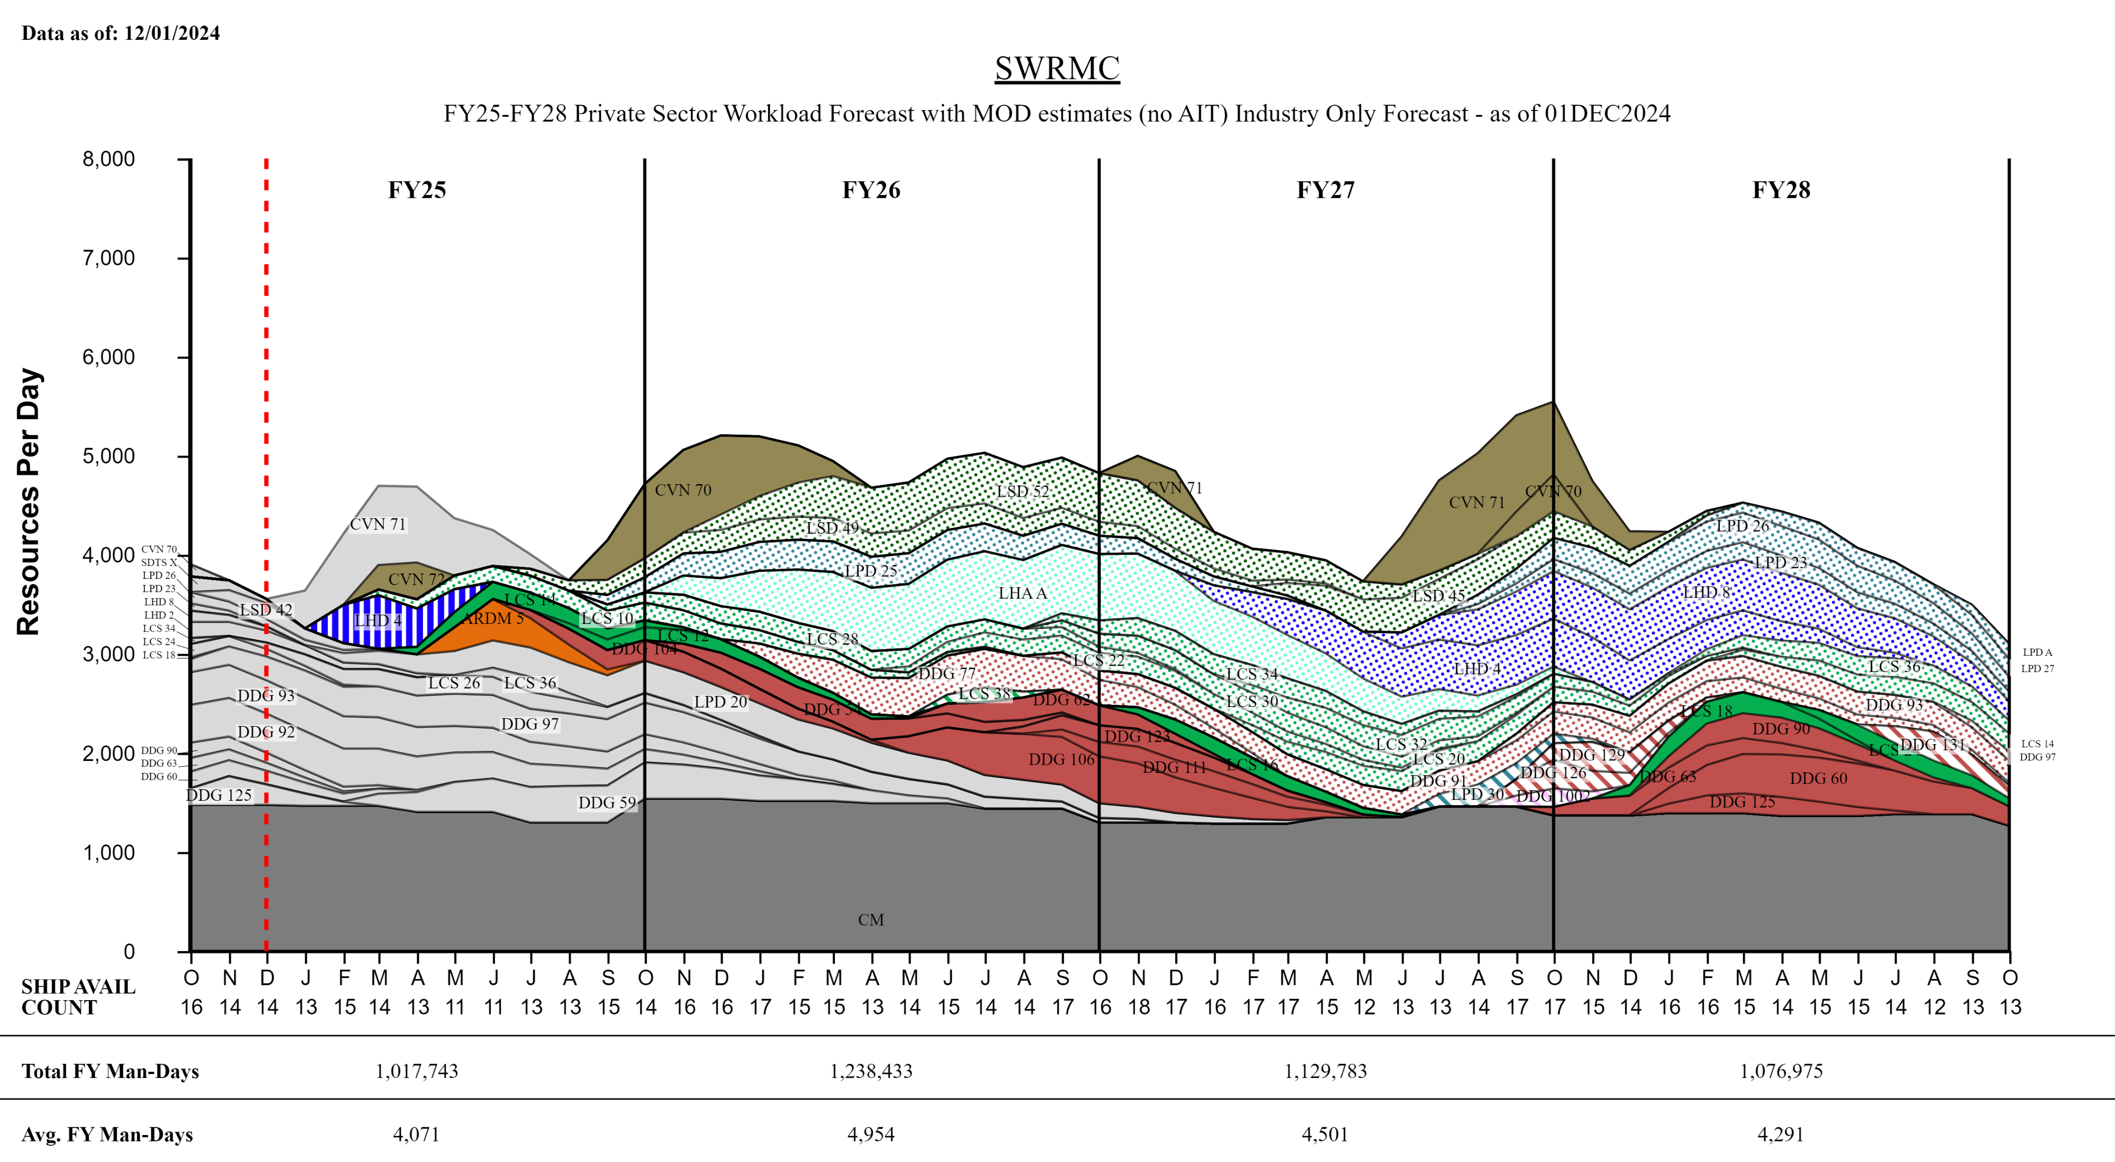
SWRMC Private Sector
TIME NOW
“Intent of this information is to provide U.S. DoD industry contractors a general schedule for information and planning purposes for upcoming surface ship maintenance periods- It does not constitute any request for information or request for proposals or any commitment to contract for work in accordance with this plan. This information is to assist U.S. DoD industry contractors by providing a broad overview of frequently changing (driven by U.S. Navy operations) maintenance schedules and is not a guarantee of workload or exact ship schedules”
“Distribution Statement A: Approved for Public Release; Distribution is unlimited.”

Slide 8
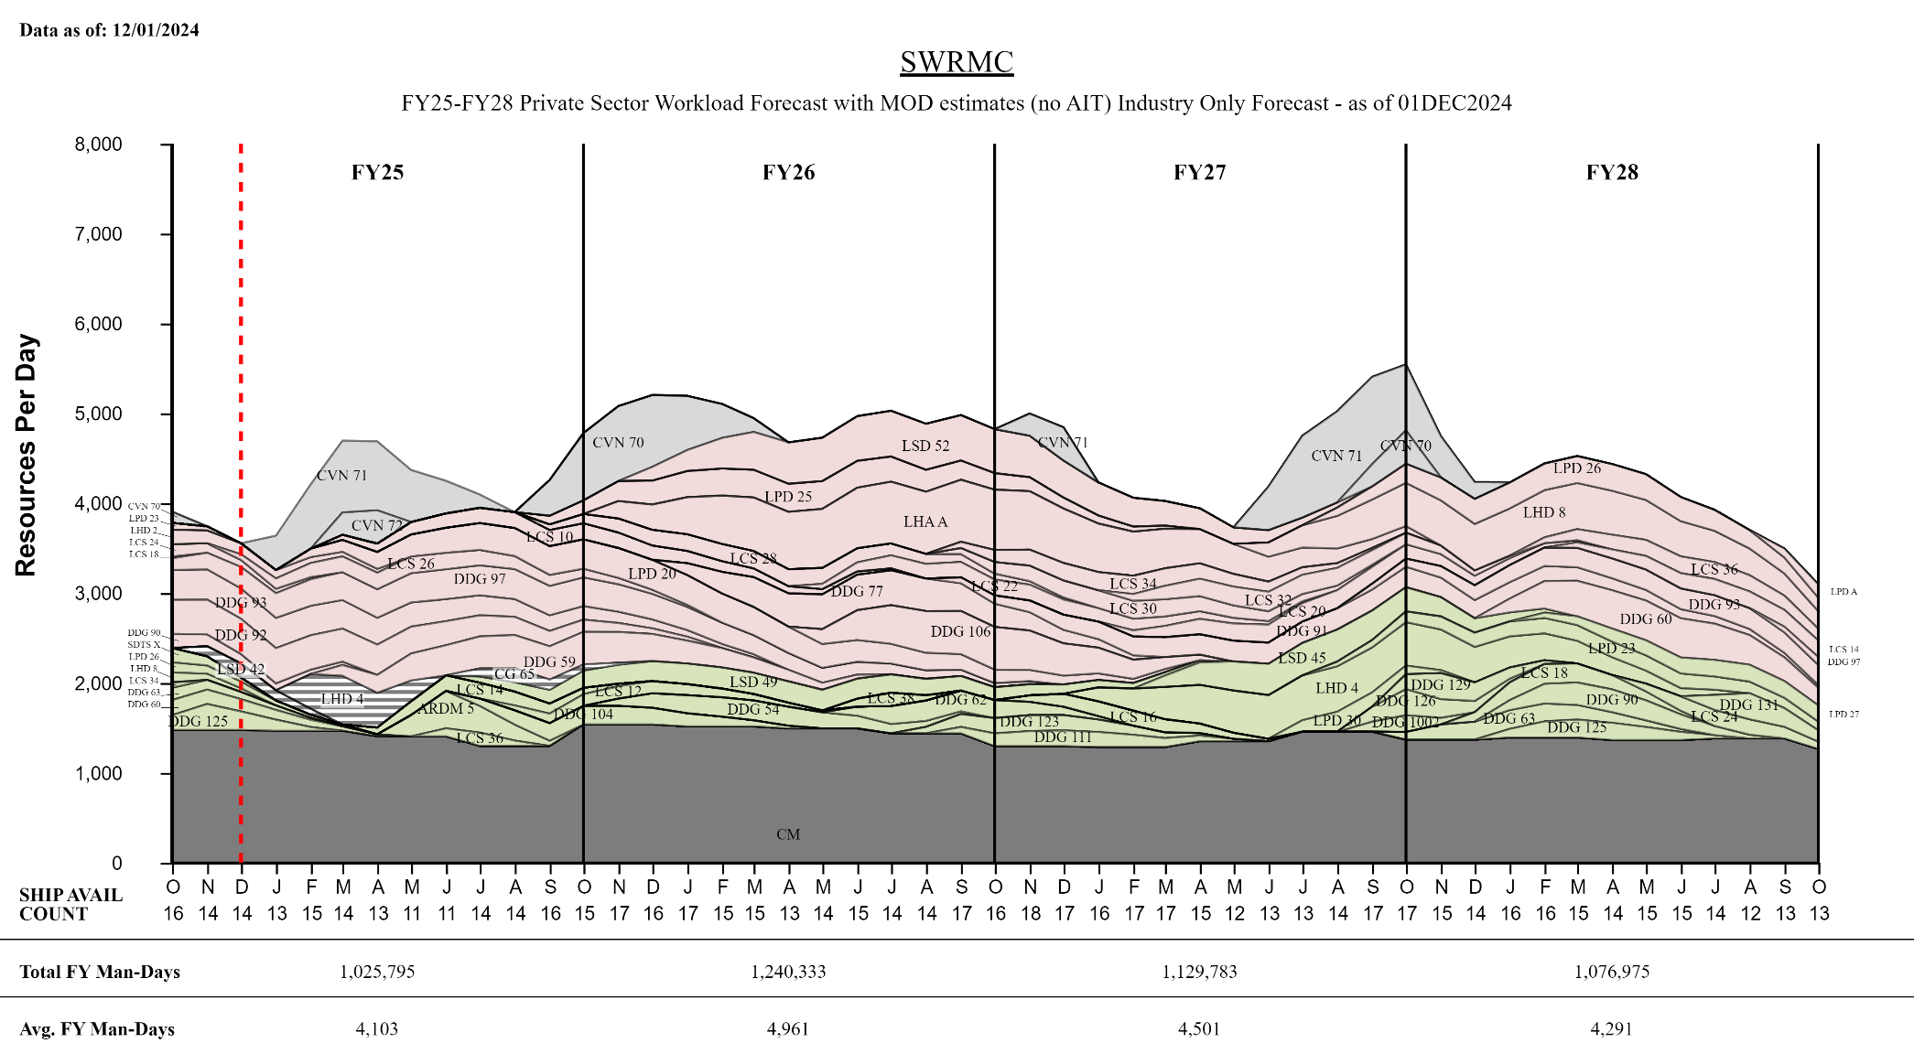
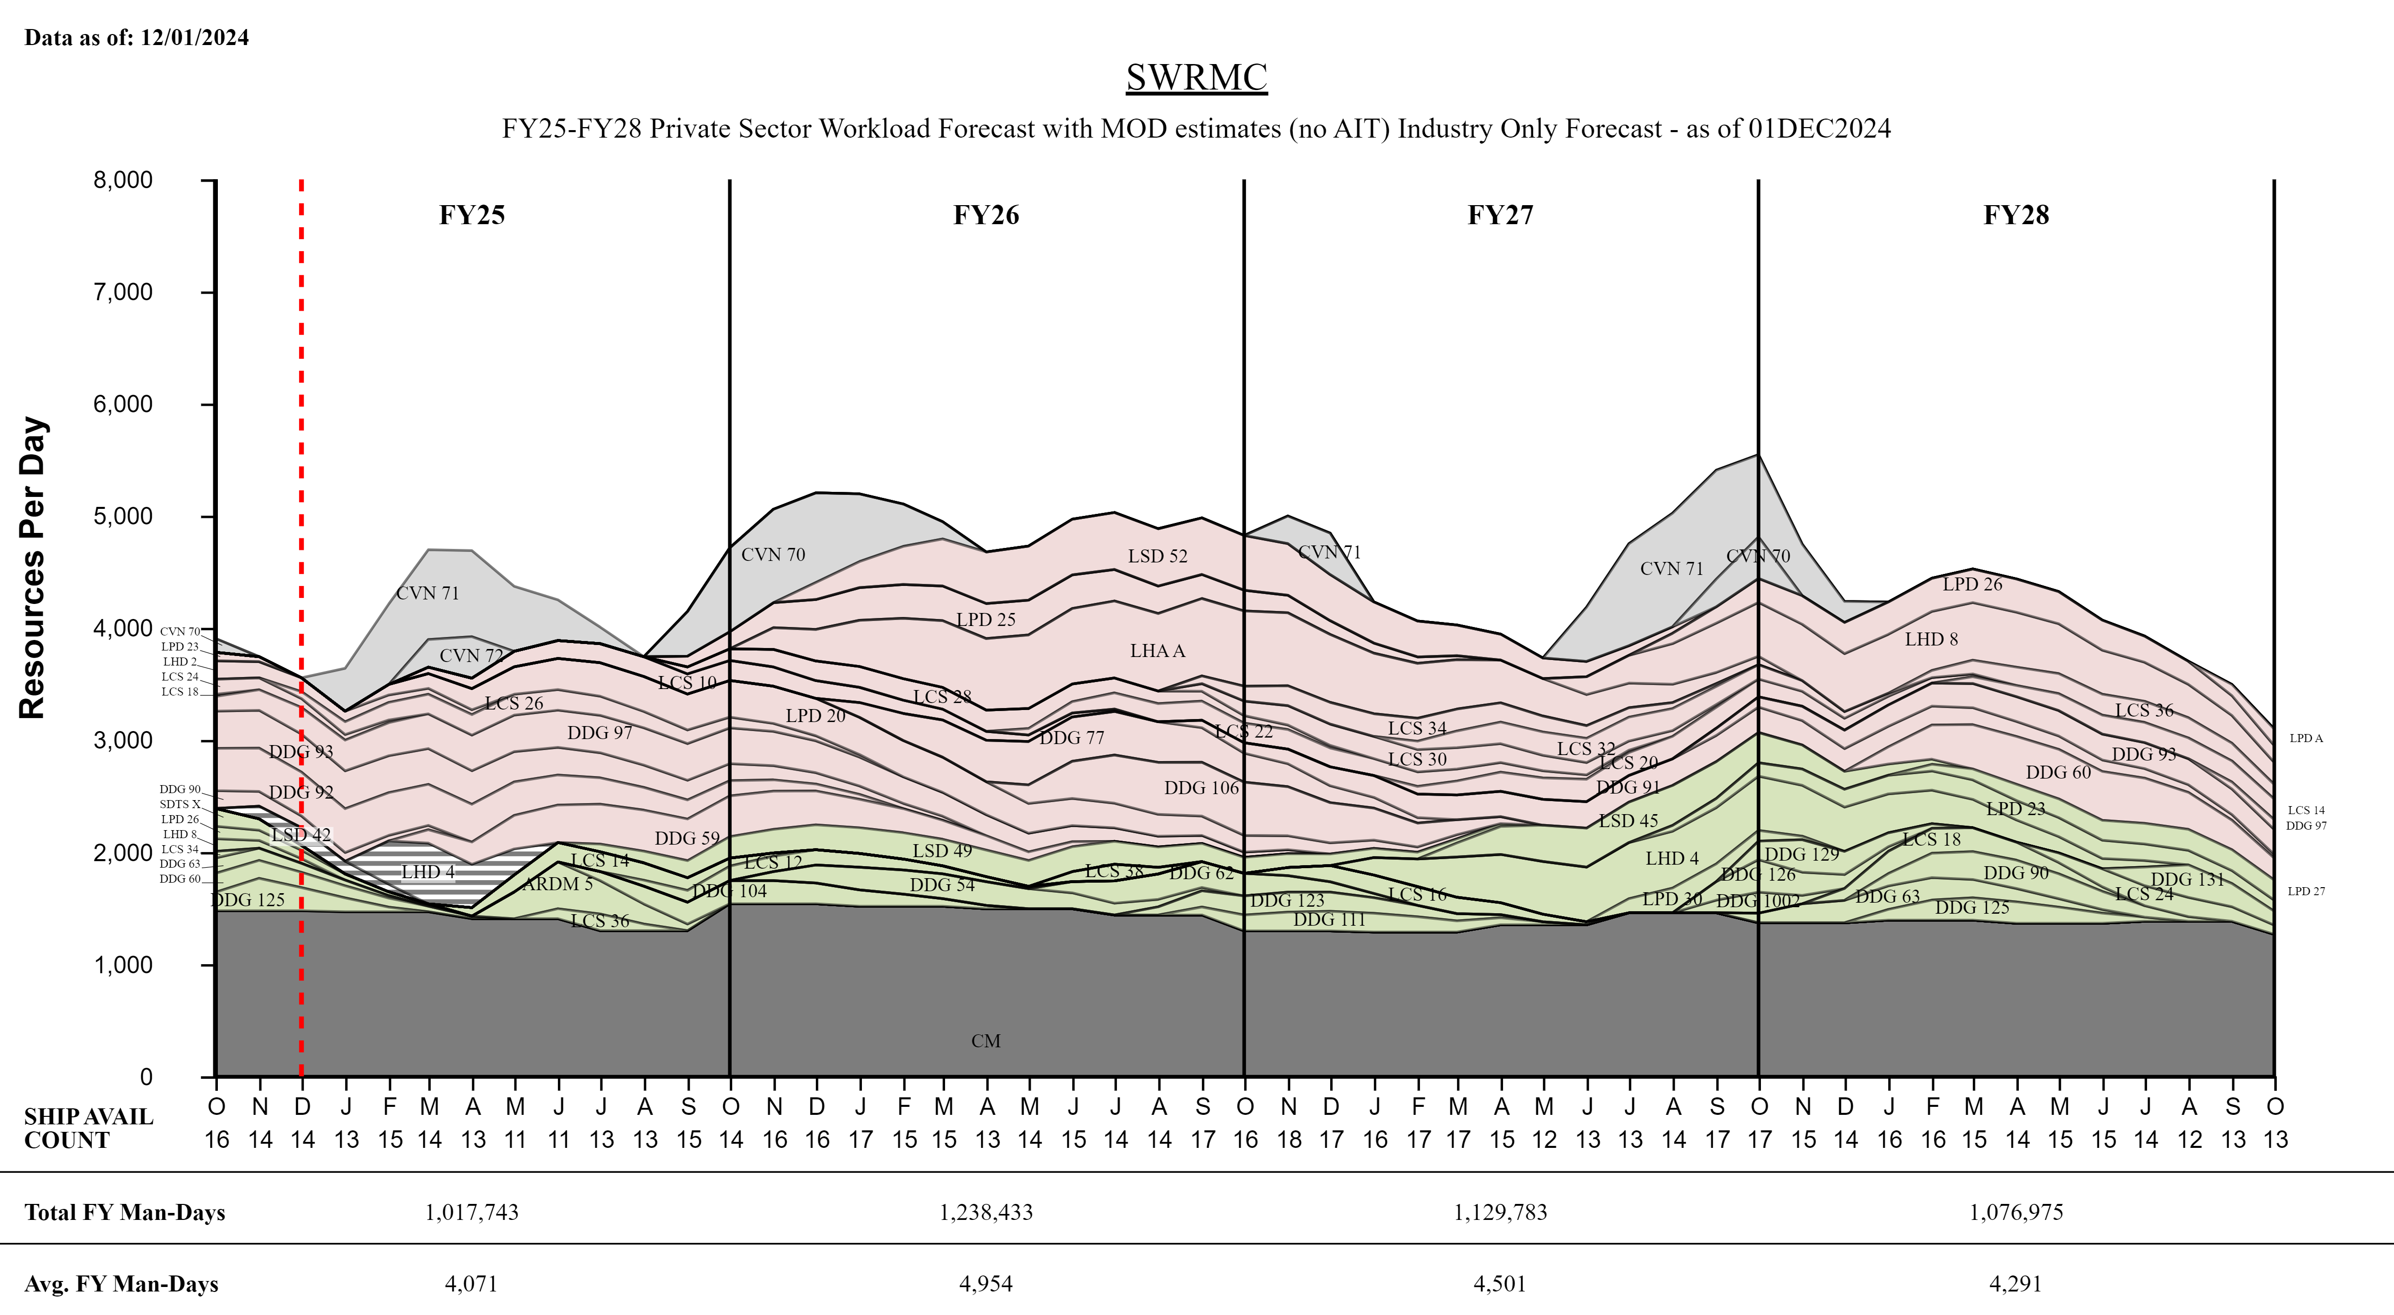
SWRMC Private Sector
TIME NOW
“Intent of this information is to provide U.S. DoD industry contractors a general schedule for information and planning purposes for upcoming surface ship maintenance periods- It does not constitute any request for information or request for proposals or any commitment to contract for work in accordance with this plan. This information is to assist U.S. DoD industry contractors by providing a broad overview of frequently changing (driven by U.S. Navy operations) maintenance schedules and is not a guarantee of workload or exact ship schedules”
“Distribution Statement A: Approved for Public Release; Distribution is unlimited.”

Slide 9
SWRMC Private Sector
Workload Forecast with MOD estimates (no AIT) FY25 - FY26
Industry Forecast - as of 01 DEC 2024
“Intent of this information is to provide U.S. DoD industry contractors a general schedule for information and planning purposes for upcoming surface ship maintenance periods- It does not constitute any request for information or request for proposals or any commitment to contract for work in accordance with this plan. This information is to assist U.S. DoD industry contractors by providing a broad overview of frequently changing (driven by U.S. Navy operations) maintenance schedules and is not a guarantee of workload or exact ship schedules”
“Distribution Statement A: Approved for Public Release; Distribution is unlimited.”

Slide 10
SWRMC Private Sector
Workload Forecast with MOD estimates (no AIT) FY27 - FY28
Industry Forecast - as of 01 DEC 2024
“Intent of this information is to provide U.S. DoD industry contractors a general schedule for information and planning purposes for upcoming surface ship maintenance periods- It does not constitute any request for information or request for proposals or any commitment to contract for work in accordance with this plan. This information is to assist U.S. DoD industry contractors by providing a broad overview of frequently changing (driven by U.S. Navy operations) maintenance schedules and is not a guarantee of workload or exact ship schedules”
“Distribution Statement A: Approved for Public Release; Distribution is unlimited.”

Slide 11
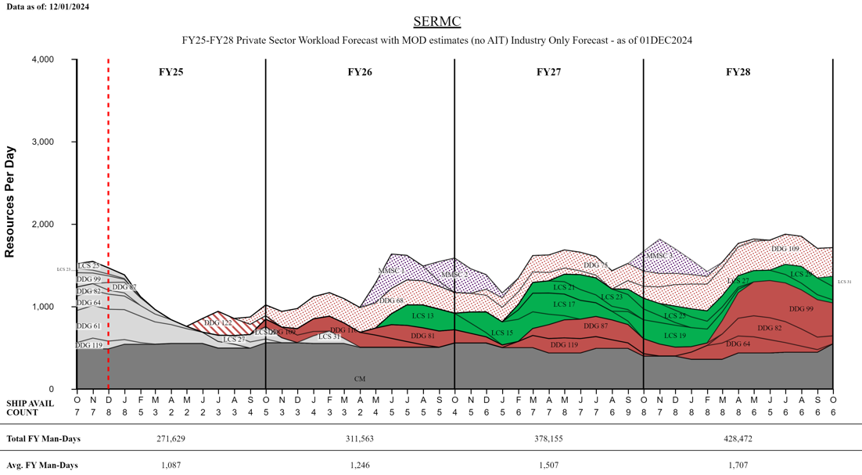
SERMC Private Sector
TIME NOW
“Intent of this information is to provide U.S. DoD industry contractors a general schedule for information and planning purposes for upcoming surface ship maintenance periods- It does not constitute any request for information or request for proposals or any commitment to contract for work in accordance with this plan. This information is to assist U.S. DoD industry contractors by providing a broad overview of frequently changing (driven by U.S. Navy operations) maintenance schedules and is not a guarantee of workload or exact ship schedules”
“Distribution Statement A: Approved for Public Release; Distribution is unlimited.”

Slide 12
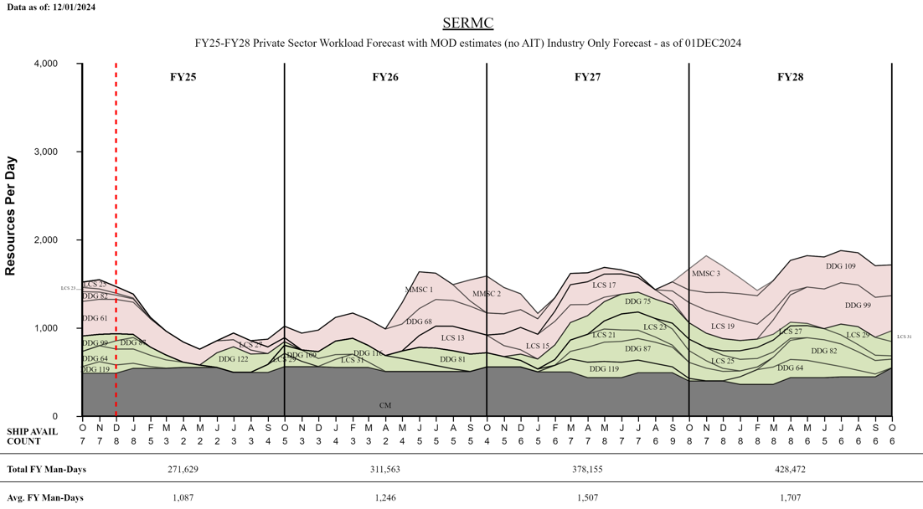
SERMC Private Sector
TIME NOW
“Intent of this information is to provide U.S. DoD industry contractors a general schedule for information and planning purposes for upcoming surface ship maintenance periods- It does not constitute any request for information or request for proposals or any commitment to contract for work in accordance with this plan. This information is to assist U.S. DoD industry contractors by providing a broad overview of frequently changing (driven by U.S. Navy operations) maintenance schedules and is not a guarantee of workload or exact ship schedules”
“Distribution Statement A: Approved for Public Release; Distribution is unlimited.”

Slide 13
SERMC Private Sector
Workload Forecast with MOD estimates (no AIT) FY25 - FY26
Industry Forecast - as of 01 DEC 2024
“Intent of this information is to provide U.S. DoD industry contractors a general schedule for information and planning purposes for upcoming surface ship maintenance periods- It does not constitute any request for information or request for proposals or any commitment to contract for work in accordance with this plan. This information is to assist U.S. DoD industry contractors by providing a broad overview of frequently changing (driven by U.S. Navy operations) maintenance schedules and is not a guarantee of workload or exact ship schedules”
“Distribution Statement A: Approved for Public Release; Distribution is unlimited.”

Slide 14
SERMC Private Sector
Workload Forecast with MOD estimates (no AIT) FY27 - FY28
Industry Forecast - as of 01 DEC 2024
“Intent of this information is to provide U.S. DoD industry contractors a general schedule for information and planning purposes for upcoming surface ship maintenance periods- It does not constitute any request for information or request for proposals or any commitment to contract for work in accordance with this plan. This information is to assist U.S. DoD industry contractors by providing a broad overview of frequently changing (driven by U.S. Navy operations) maintenance schedules and is not a guarantee of workload or exact ship schedules”
“Distribution Statement A: Approved for Public Release; Distribution is unlimited.”

Slide 15
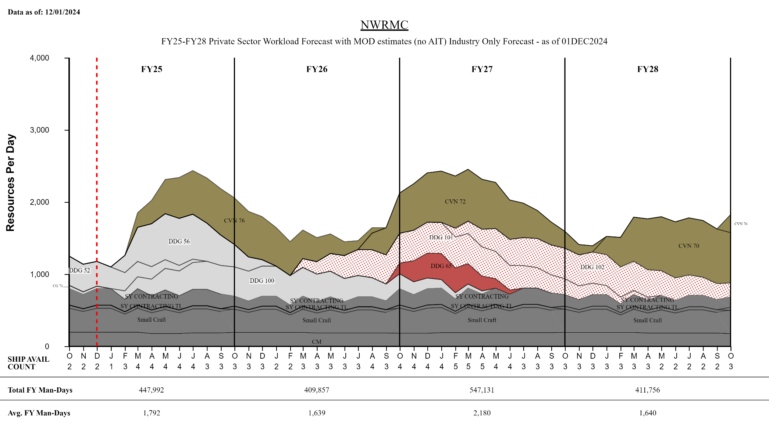
NWRMC Private Sector
TIME NOW
“Intent of this information is to provide U.S. DoD industry contractors a general schedule for information and planning purposes for upcoming surface ship maintenance periods- It does not constitute any request for information or request for proposals or any commitment to contract for work in accordance with this plan. This information is to assist U.S. DoD industry contractors by providing a broad overview of frequently changing (driven by U.S. Navy operations) maintenance schedules and is not a guarantee of workload or exact ship schedules”
“Distribution Statement A: Approved for Public Release; Distribution is unlimited.”

Slide 16
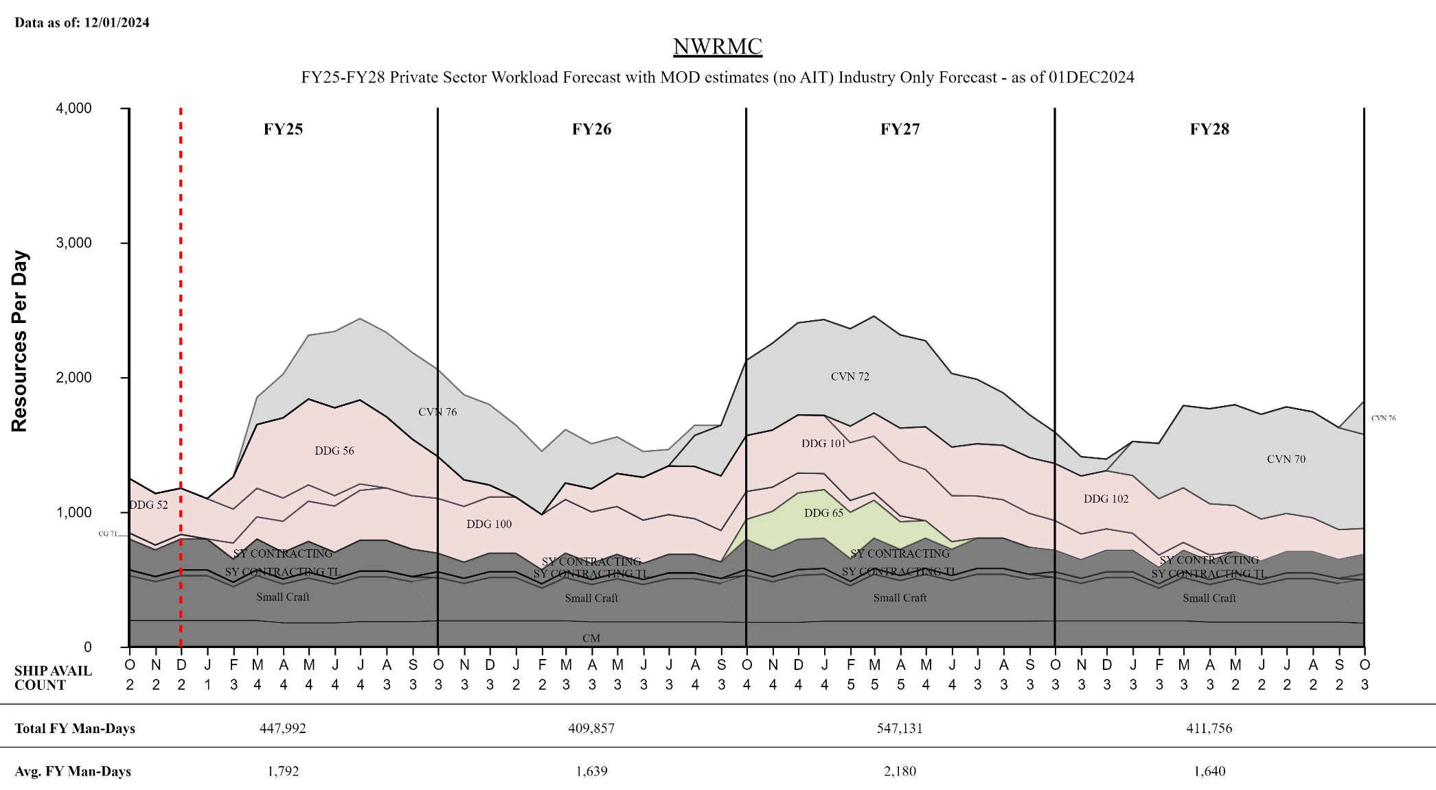
NWRMC Private Sector
TIME NOW
“Intent of this information is to provide U.S. DoD industry contractors a general schedule for information and planning purposes for upcoming surface ship maintenance periods- It does not constitute any request for information or request for proposals or any commitment to contract for work in accordance with this plan. This information is to assist U.S. DoD industry contractors by providing a broad overview of frequently changing (driven by U.S. Navy operations) maintenance schedules and is not a guarantee of workload or exact ship schedules”
“Distribution Statement A: Approved for Public Release; Distribution is unlimited.”

Slide 17
NWRMC Private Sector
Workload Forecast with MOD estimates (no AIT) FY25 - FY28
Industry Forecast - as of 01 DEC 2024
“Intent of this information is to provide U.S. DoD industry contractors a general schedule for information and planning purposes for upcoming surface ship maintenance periods- It does not constitute any request for information or request for proposals or any commitment to contract for work in accordance with this plan. This information is to assist U.S. DoD industry contractors by providing a broad overview of frequently changing (driven by U.S. Navy operations) maintenance schedules and is not a guarantee of workload or exact ship schedules”
“Distribution Statement A: Approved for Public Release; Distribution is unlimited.”

Slide 18
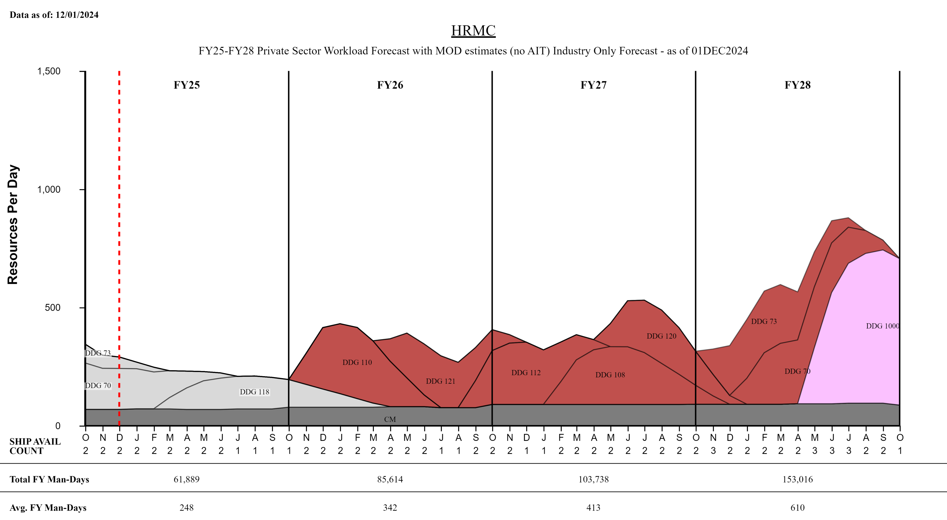
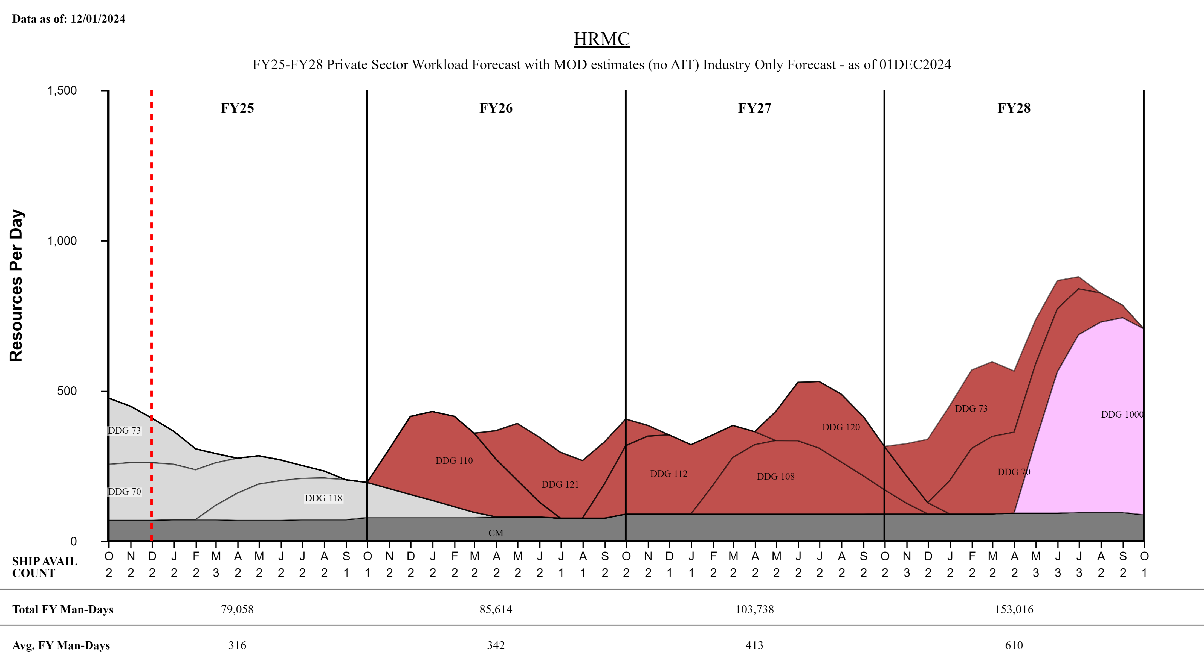
HRMC Private Sector
TIME NOW
“Intent of this information is to provide U.S. DoD industry contractors a general schedule for information and planning purposes for upcoming surface ship maintenance periods- It does not constitute any request for information or request for proposals or any commitment to contract for work in accordance with this plan. This information is to assist U.S. DoD industry contractors by providing a broad overview of frequently changing (driven by U.S. Navy operations) maintenance schedules and is not a guarantee of workload or exact ship schedules”
“Distribution Statement A: Approved for Public Release; Distribution is unlimited.”

Slide 19
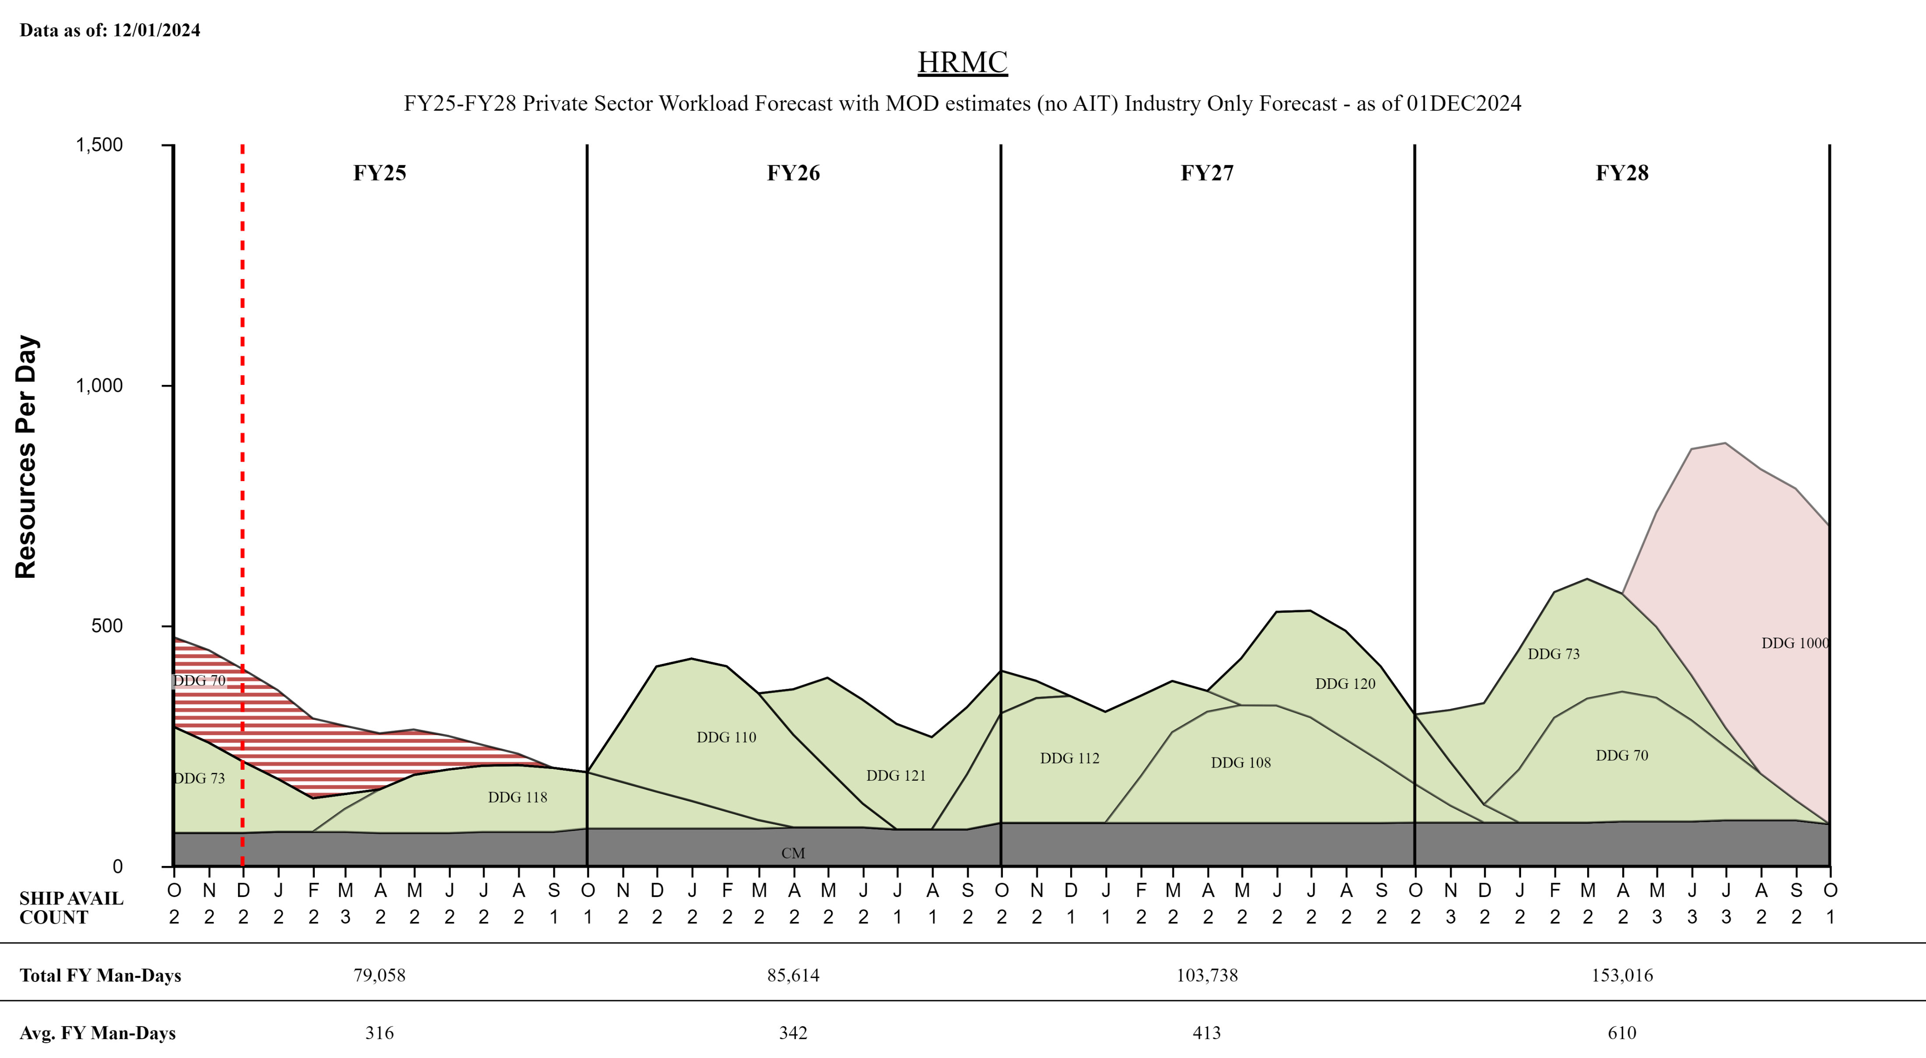
HRMC Private Sector
TIME NOW
“Intent of this information is to provide U.S. DoD industry contractors a general schedule for information and planning purposes for upcoming surface ship maintenance periods- It does not constitute any request for information or request for proposals or any commitment to contract for work in accordance with this plan. This information is to assist U.S. DoD industry contractors by providing a broad overview of frequently changing (driven by U.S. Navy operations) maintenance schedules and is not a guarantee of workload or exact ship schedules”
“Distribution Statement A: Approved for Public Release; Distribution is unlimited.”

Slide 20
HRMC Private Sector
Workload Forecast with MOD estimates (no AIT) FY25 - FY28
Industry Forecast - as of 01 DEC 2024
“Intent of this information is to provide U.S. DoD industry contractors a general schedule for information and planning purposes for upcoming surface ship maintenance periods- It does not constitute any request for information or request for proposals or any commitment to contract for work in accordance with this plan. This information is to assist U.S. DoD industry contractors by providing a broad overview of frequently changing (driven by U.S. Navy operations) maintenance schedules and is not a guarantee of workload or exact ship schedules”
“Distribution Statement A: Approved for Public Release; Distribution is unlimited.”

