Slide 1

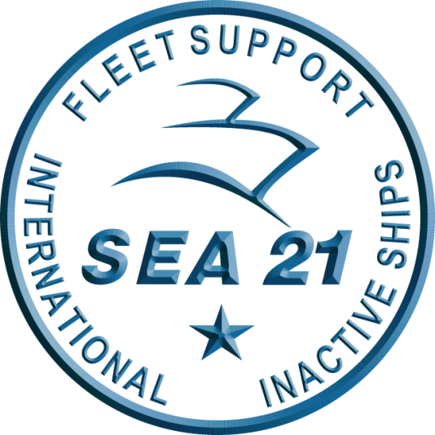
Domestic Private Sector Workload Estimate
FY24 - FY27 Workload as of 01 APR 2024
Industry Version FY24 Q3 M1
“Intent of this information is to provide U.S. DoD industry contractors a general schedule for information and planning purposes for upcoming surface ship maintenance periods- It does not constitute any request for information or request for proposals or any commitment to contract for work in accordance with this plan. This information is to assist U.S. DoD industry contractors by providing a broad overview of frequently changing (driven by U.S. Navy operations) maintenance schedules and is not a guarantee of workload or exact ship schedules”
“Distribution Statement A: Approved for Public Release; Distribution is unlimited.”

Slide 2
Notes
Data contained in this report reflects the Navy program of record as of 01 APRIL 2024.
The next bi-monthly workload projections are targeted for release no later than 30 JUNE 2024.
Industry manning impacts, results of ongoing availability duration and schedule review, tailored acquisition strategies and ongoing budget negotiations may refine out-year projections.
This (01 APRIL 2024) workload does not reflect the results of the Fleet Scheduling Conference held 08-12 APRIL 2024.
“Intent of this information is to provide U.S. DoD industry contractors a general schedule for information and planning purposes for upcoming surface ship maintenance periods- It does not constitute any request for information or request for proposals or any commitment to contract for work in accordance with this plan. This information is to assist U.S. DoD industry contractors by providing a broad overview of frequently changing (driven by U.S. Navy operations) maintenance schedules and is not a guarantee of workload or exact ship schedules”
“Distribution Statement A: Approved for Public Release; Distribution is unlimited.”

Slide 3
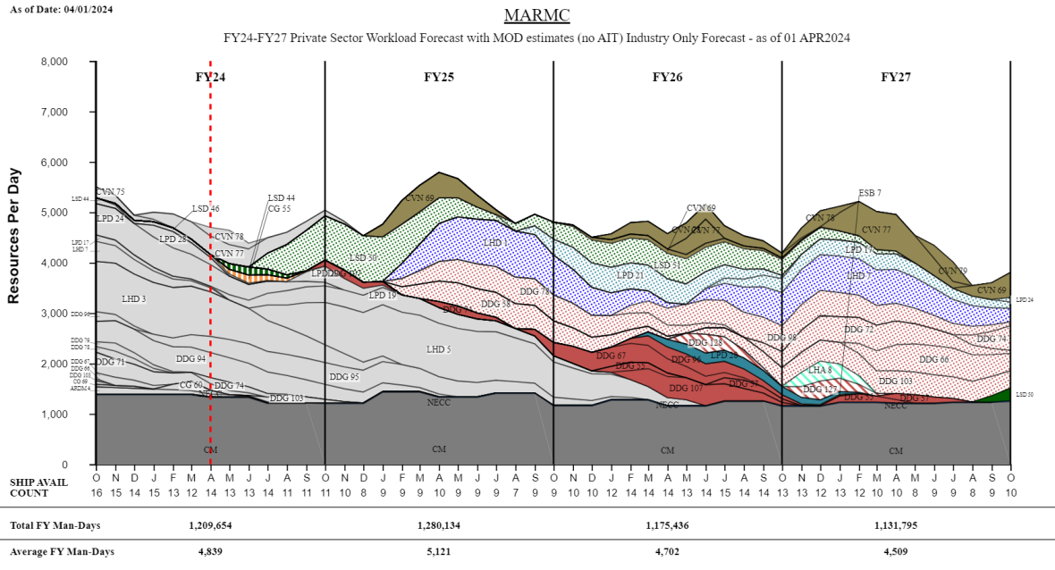
MARMC Private Sector
TIME NOW
“Intent of this information is to provide U.S. DoD industry contractors a general schedule for information and planning purposes for upcoming surface ship maintenance periods- It does not constitute any request for information or request for proposals or any commitment to contract for work in accordance with this plan. This information is to assist U.S. DoD industry contractors by providing a broad overview of frequently changing (driven by U.S. Navy operations) maintenance schedules and is not a guarantee of workload or exact ship schedules”
“Distribution Statement A: Approved for Public Release; Distribution is unlimited.”

Slide 4
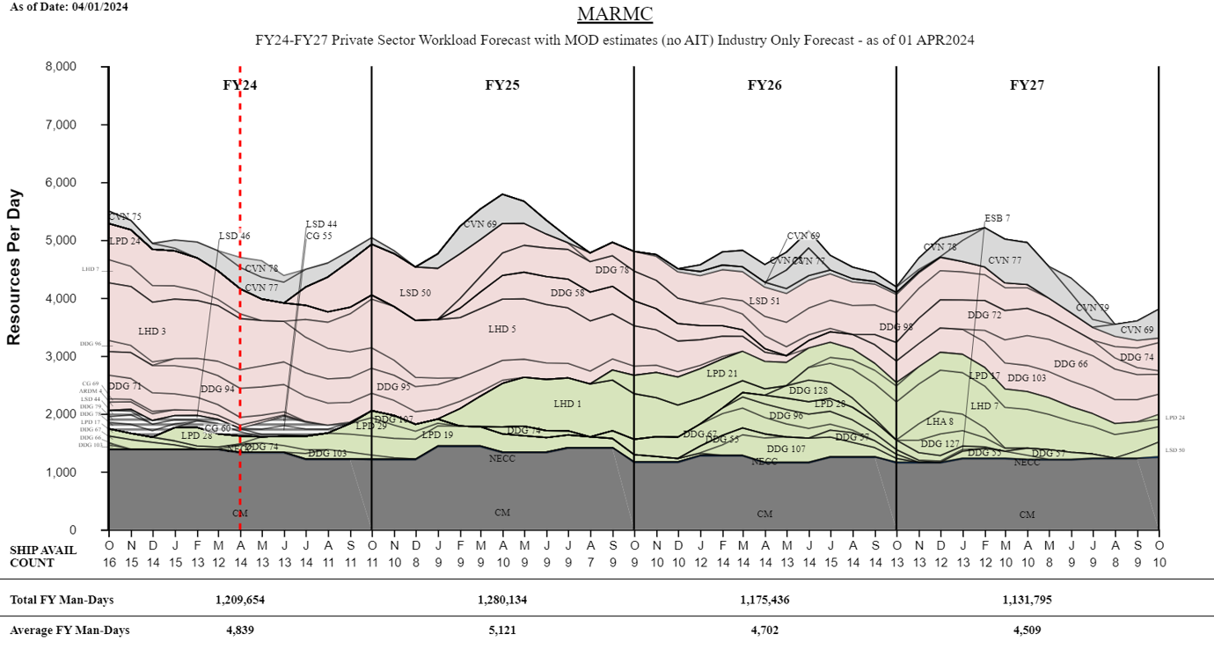
MARMC Private Sector
TIME NOW
“Intent of this information is to provide U.S. DoD industry contractors a general schedule for information and planning purposes for upcoming surface ship maintenance periods- It does not constitute any request for information or request for proposals or any commitment to contract for work in accordance with this plan. This information is to assist U.S. DoD industry contractors by providing a broad overview of frequently changing (driven by U.S. Navy operations) maintenance schedules and is not a guarantee of workload or exact ship schedules”
“Distribution Statement A: Approved for Public Release; Distribution is unlimited.”

Slide 5
MARMC Private Sector
Workload Forecast with MOD estimates (no AIT) FY24 - FY25
Industry Forecast - as of 01 APR 2024
“Intent of this information is to provide U.S. DoD industry contractors a general schedule for information and planning purposes for upcoming surface ship maintenance periods- It does not constitute any request for information or request for proposals or any commitment to contract for work in accordance with this plan. This information is to assist U.S. DoD industry contractors by providing a broad overview of frequently changing (driven by U.S. Navy operations) maintenance schedules and is not a guarantee of workload or exact ship schedules”
“Distribution Statement A: Approved for Public Release; Distribution is unlimited.”

Slide 6
MARMC Private Sector
Workload Forecast with MOD estimates (no AIT) FY26 - FY27
Industry Forecast - as of 01 APR 2024
“Intent of this information is to provide U.S. DoD industry contractors a general schedule for information and planning purposes for upcoming surface ship maintenance periods- It does not constitute any request for information or request for proposals or any commitment to contract for work in accordance with this plan. This information is to assist U.S. DoD industry contractors by providing a broad overview of frequently changing (driven by U.S. Navy operations) maintenance schedules and is not a guarantee of workload or exact ship schedules”
“Distribution Statement A: Approved for Public Release; Distribution is unlimited.”

Slide 7
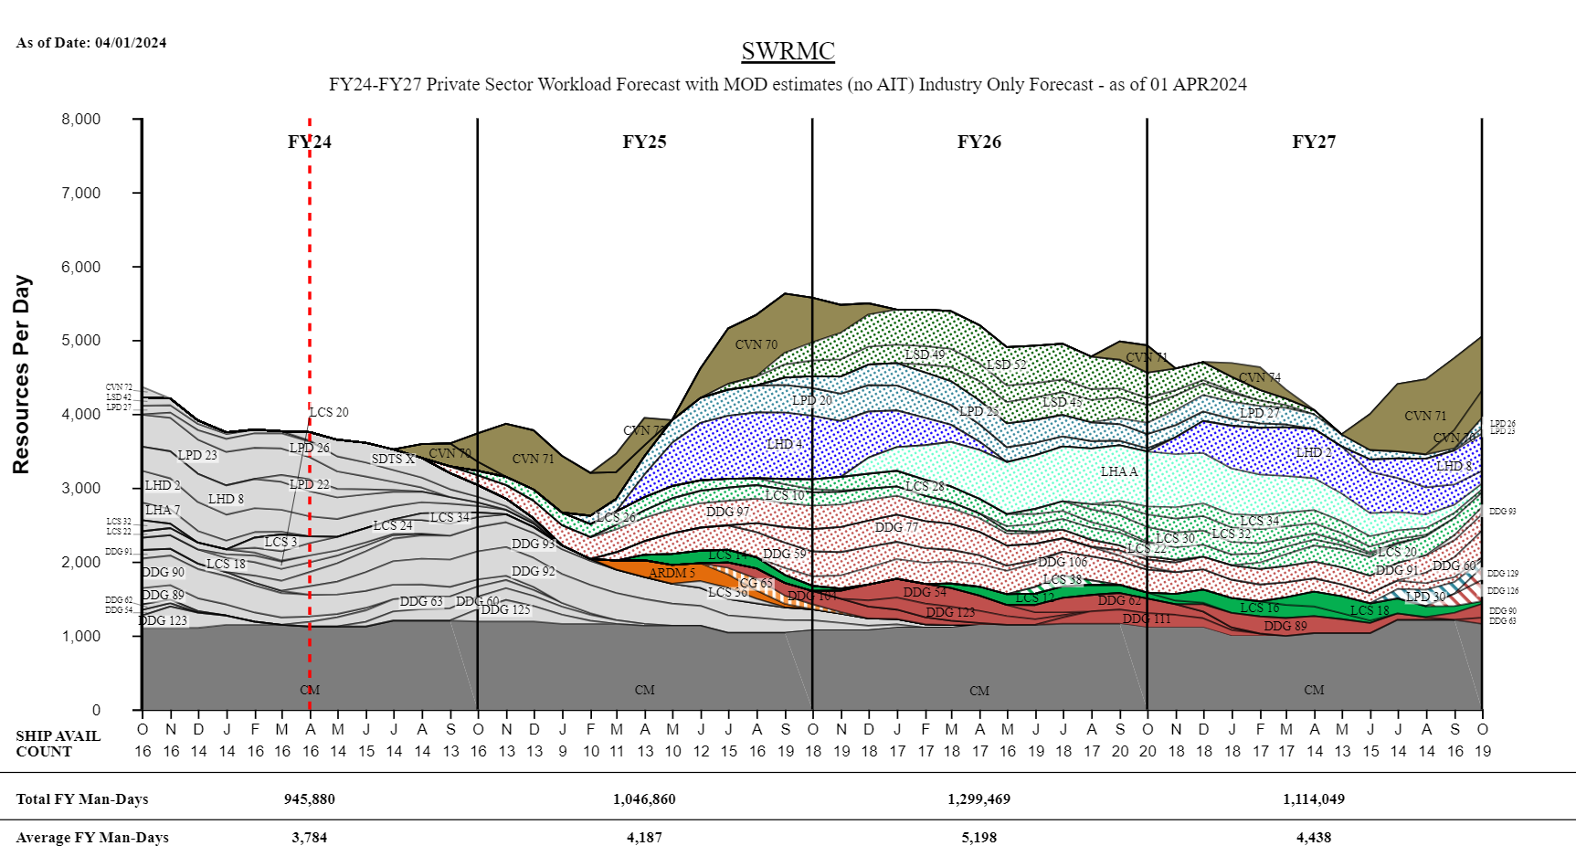
SWRMC Private Sector
TIME NOW
“Intent of this information is to provide U.S. DoD industry contractors a general schedule for information and planning purposes for upcoming surface ship maintenance periods- It does not constitute any request for information or request for proposals or any commitment to contract for work in accordance with this plan. This information is to assist U.S. DoD industry contractors by providing a broad overview of frequently changing (driven by U.S. Navy operations) maintenance schedules and is not a guarantee of workload or exact ship schedules”
“Distribution Statement A: Approved for Public Release; Distribution is unlimited.”

Slide 8
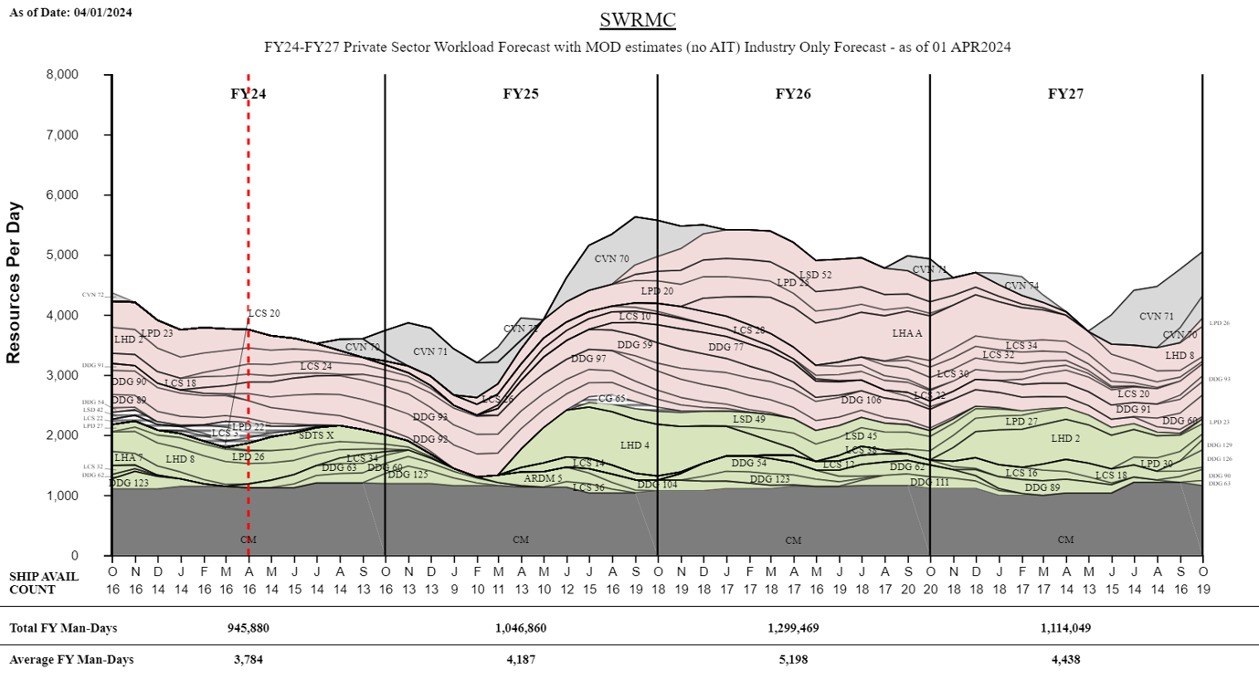
SWRMC Private Sector
TIME NOW
“Intent of this information is to provide U.S. DoD industry contractors a general schedule for information and planning purposes for upcoming surface ship maintenance periods- It does not constitute any request for information or request for proposals or any commitment to contract for work in accordance with this plan. This information is to assist U.S. DoD industry contractors by providing a broad overview of frequently changing (driven by U.S. Navy operations) maintenance schedules and is not a guarantee of workload or exact ship schedules”
“Distribution Statement A: Approved for Public Release; Distribution is unlimited.”

Slide 9
SWRMC Private Sector
Workload Forecast with MOD estimates (no AIT) FY24 - FY25
Industry Forecast - as of 01 APR 2024
“Intent of this information is to provide U.S. DoD industry contractors a general schedule for information and planning purposes for upcoming surface ship maintenance periods- It does not constitute any request for information or request for proposals or any commitment to contract for work in accordance with this plan. This information is to assist U.S. DoD industry contractors by providing a broad overview of frequently changing (driven by U.S. Navy operations) maintenance schedules and is not a guarantee of workload or exact ship schedules”
“Distribution Statement A: Approved for Public Release; Distribution is unlimited.”

Slide 10
SWRMC Private Sector
Workload Forecast with MOD estimates (no AIT) FY26 - FY27
Industry Forecast - as of 01 APR 2024
“Intent of this information is to provide U.S. DoD industry contractors a general schedule for information and planning purposes for upcoming surface ship maintenance periods- It does not constitute any request for information or request for proposals or any commitment to contract for work in accordance with this plan. This information is to assist U.S. DoD industry contractors by providing a broad overview of frequently changing (driven by U.S. Navy operations) maintenance schedules and is not a guarantee of workload or exact ship schedules”
“Distribution Statement A: Approved for Public Release; Distribution is unlimited.”

Slide 11
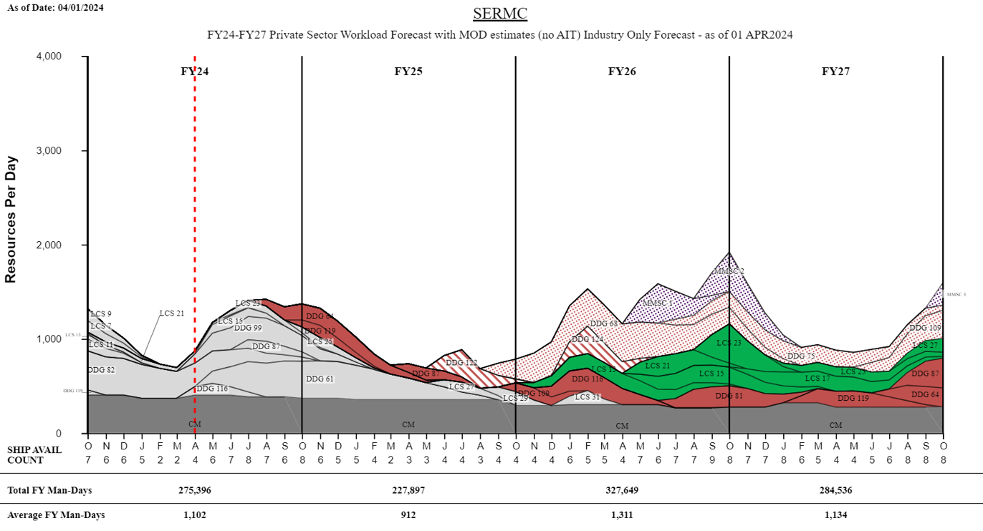
SERMC Private Sector
TIME NOW
“Intent of this information is to provide U.S. DoD industry contractors a general schedule for information and planning purposes for upcoming surface ship maintenance periods- It does not constitute any request for information or request for proposals or any commitment to contract for work in accordance with this plan. This information is to assist U.S. DoD industry contractors by providing a broad overview of frequently changing (driven by U.S. Navy operations) maintenance schedules and is not a guarantee of workload or exact ship schedules”
“Distribution Statement A: Approved for Public Release; Distribution is unlimited.”

Slide 12
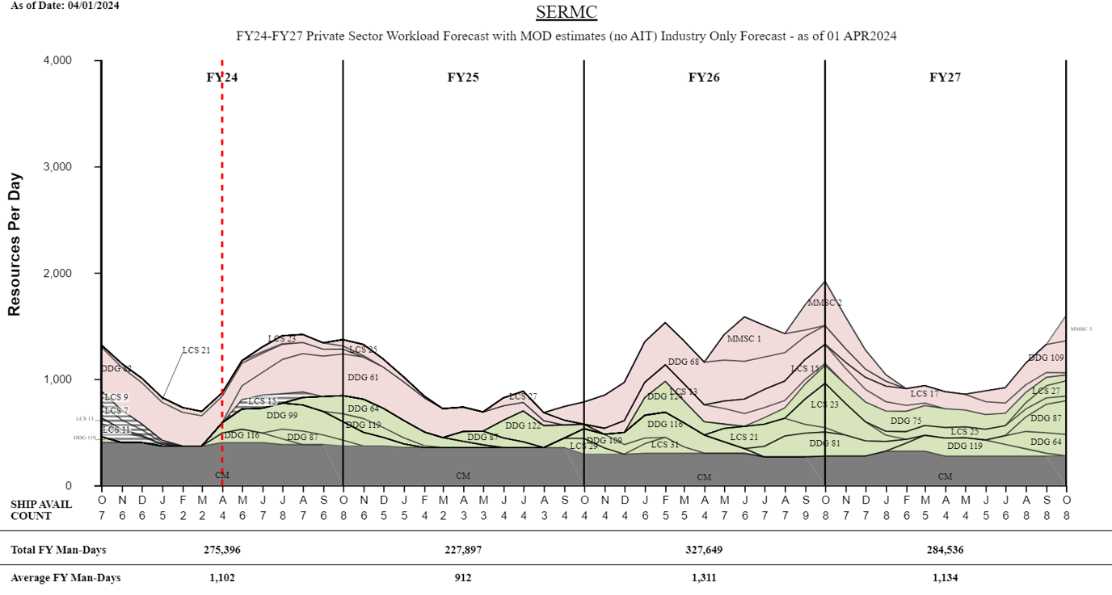
SERMC Private Sector
TIME NOW
“Intent of this information is to provide U.S. DoD industry contractors a general schedule for information and planning purposes for upcoming surface ship maintenance periods- It does not constitute any request for information or request for proposals or any commitment to contract for work in accordance with this plan. This information is to assist U.S. DoD industry contractors by providing a broad overview of frequently changing (driven by U.S. Navy operations) maintenance schedules and is not a guarantee of workload or exact ship schedules”
“Distribution Statement A: Approved for Public Release; Distribution is unlimited.”

Slide 13
SERMC Private Sector
Workload Forecast with MOD estimates (no AIT) FY24 - FY25
Industry Forecast - as of 01 APR 2024
“Intent of this information is to provide U.S. DoD industry contractors a general schedule for information and planning purposes for upcoming surface ship maintenance periods- It does not constitute any request for information or request for proposals or any commitment to contract for work in accordance with this plan. This information is to assist U.S. DoD industry contractors by providing a broad overview of frequently changing (driven by U.S. Navy operations) maintenance schedules and is not a guarantee of workload or exact ship schedules”
“Distribution Statement A: Approved for Public Release; Distribution is unlimited.”

Slide 14
SERMC Private Sector
Workload Forecast with MOD estimates (no AIT) FY26 - FY27
Industry Forecast - as of 01 APR 2024
“Intent of this information is to provide U.S. DoD industry contractors a general schedule for information and planning purposes for upcoming surface ship maintenance periods- It does not constitute any request for information or request for proposals or any commitment to contract for work in accordance with this plan. This information is to assist U.S. DoD industry contractors by providing a broad overview of frequently changing (driven by U.S. Navy operations) maintenance schedules and is not a guarantee of workload or exact ship schedules”
“Distribution Statement A: Approved for Public Release; Distribution is unlimited.”

Slide 15
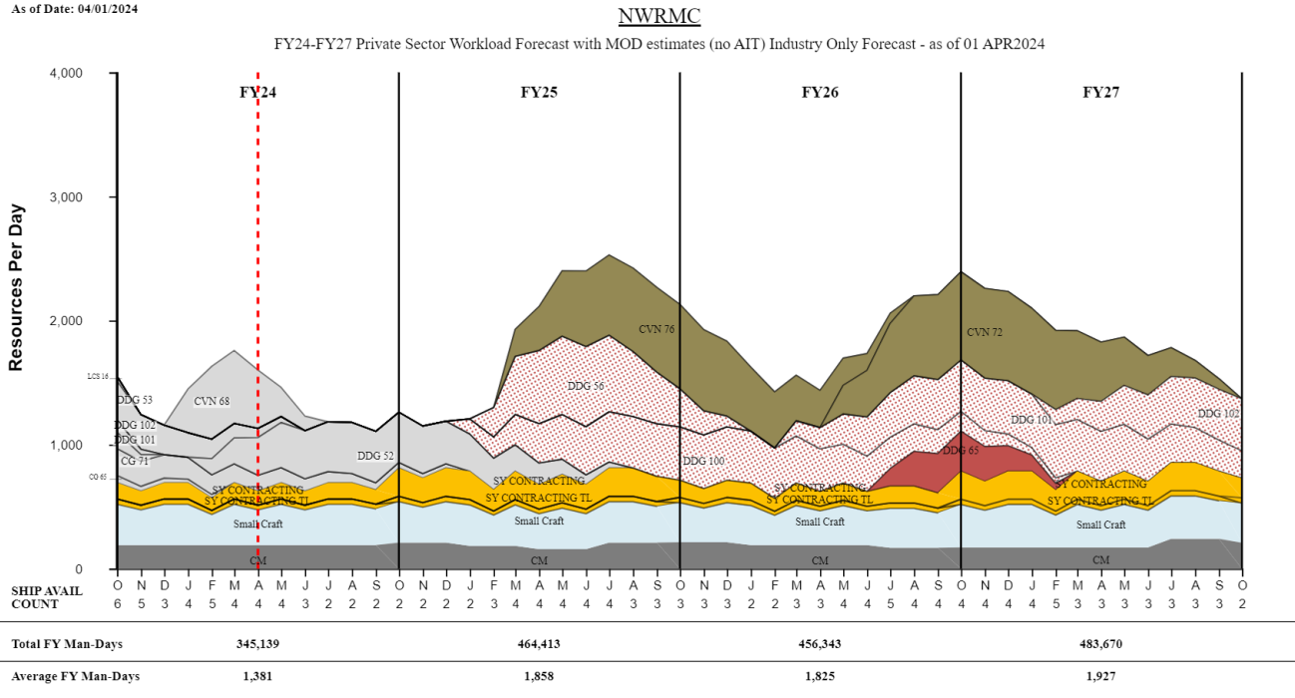
NWRMC Private Sector
TIME NOW
“Intent of this information is to provide U.S. DoD industry contractors a general schedule for information and planning purposes for upcoming surface ship maintenance periods- It does not constitute any request for information or request for proposals or any commitment to contract for work in accordance with this plan. This information is to assist U.S. DoD industry contractors by providing a broad overview of frequently changing (driven by U.S. Navy operations) maintenance schedules and is not a guarantee of workload or exact ship schedules”
“Distribution Statement A: Approved for Public Release; Distribution is unlimited.”

Slide 16
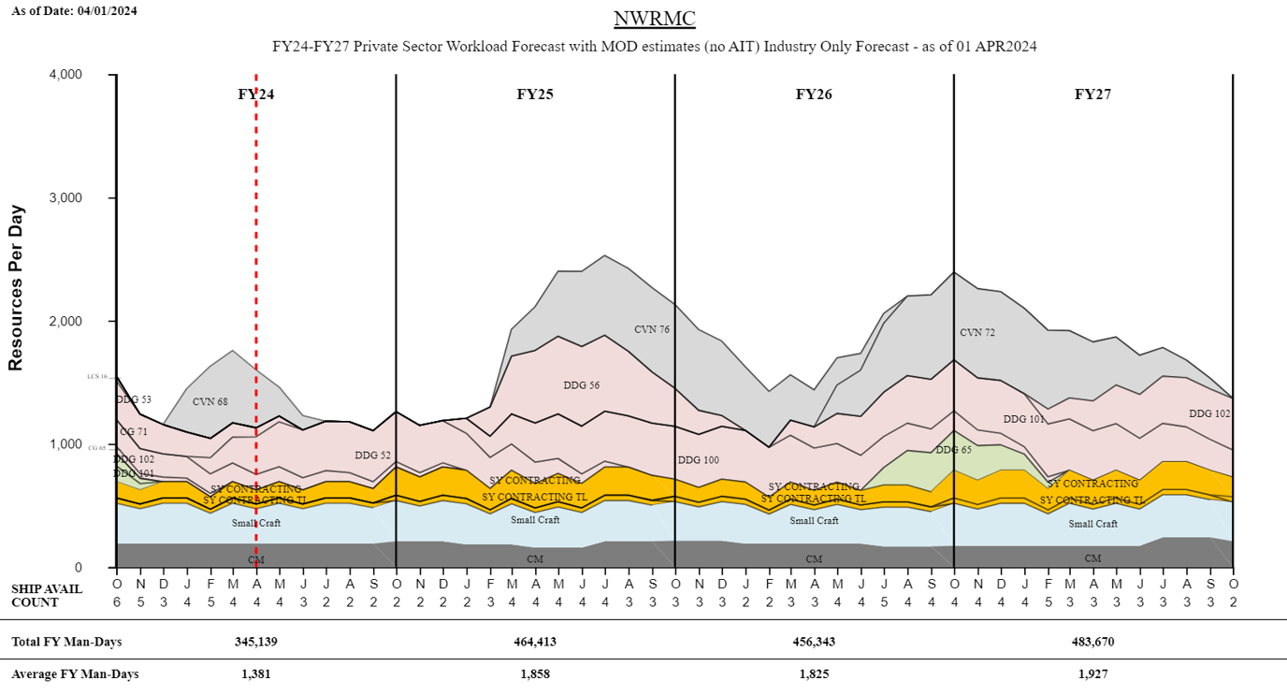
NWRMC Private Sector
TIME NOW
“Intent of this information is to provide U.S. DoD industry contractors a general schedule for information and planning purposes for upcoming surface ship maintenance periods- It does not constitute any request for information or request for proposals or any commitment to contract for work in accordance with this plan. This information is to assist U.S. DoD industry contractors by providing a broad overview of frequently changing (driven by U.S. Navy operations) maintenance schedules and is not a guarantee of workload or exact ship schedules”
“Distribution Statement A: Approved for Public Release; Distribution is unlimited.”

Slide 17
NWRMC Private Sector
Workload Forecast with MOD estimates (no AIT) FY24 - FY27
Industry Forecast - as of 01 APR 2024
“Intent of this information is to provide U.S. DoD industry contractors a general schedule for information and planning purposes for upcoming surface ship maintenance periods- It does not constitute any request for information or request for proposals or any commitment to contract for work in accordance with this plan. This information is to assist U.S. DoD industry contractors by providing a broad overview of frequently changing (driven by U.S. Navy operations) maintenance schedules and is not a guarantee of workload or exact ship schedules”
“Distribution Statement A: Approved for Public Release; Distribution is unlimited.”

Slide 18
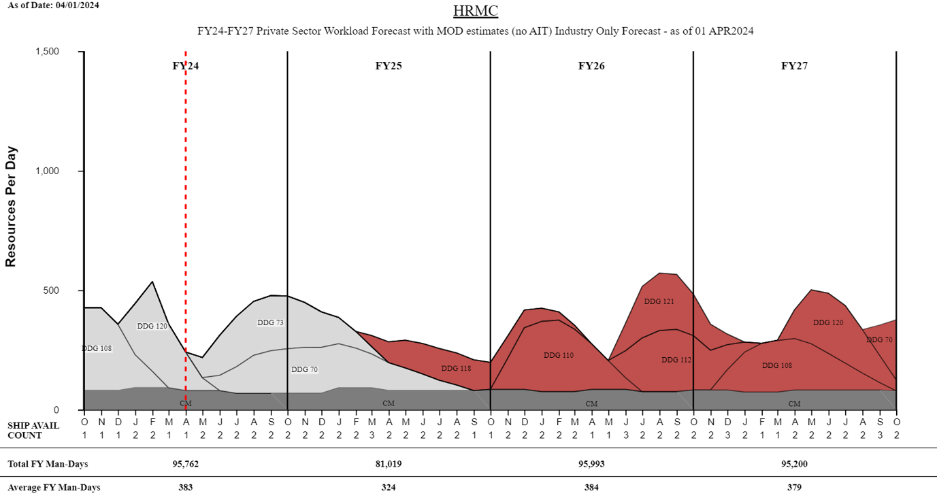
HRMC Private Sector
TIME NOW
“Intent of this information is to provide U.S. DoD industry contractors a general schedule for information and planning purposes for upcoming surface ship maintenance periods- It does not constitute any request for information or request for proposals or any commitment to contract for work in accordance with this plan. This information is to assist U.S. DoD industry contractors by providing a broad overview of frequently changing (driven by U.S. Navy operations) maintenance schedules and is not a guarantee of workload or exact ship schedules”
“Distribution Statement A: Approved for Public Release; Distribution is unlimited.”

Slide 19
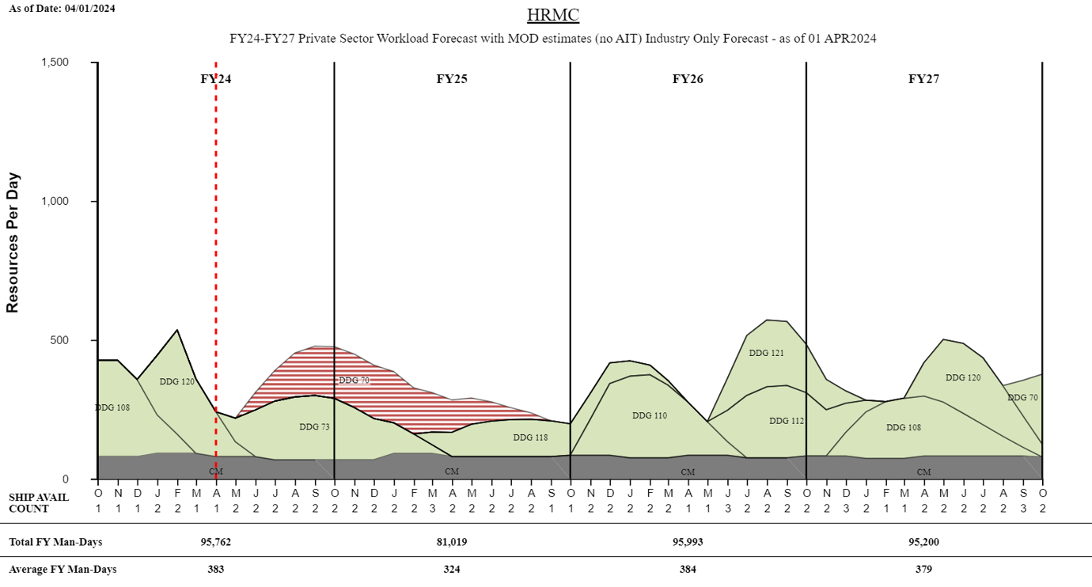
HRMC Private Sector
TIME NOW
“Intent of this information is to provide U.S. DoD industry contractors a general schedule for information and planning purposes for upcoming surface ship maintenance periods- It does not constitute any request for information or request for proposals or any commitment to contract for work in accordance with this plan. This information is to assist U.S. DoD industry contractors by providing a broad overview of frequently changing (driven by U.S. Navy operations) maintenance schedules and is not a guarantee of workload or exact ship schedules”
“Distribution Statement A: Approved for Public Release; Distribution is unlimited.”

Slide 20
HRMC Private Sector
Workload Forecast with MOD estimates (no AIT) FY24 - FY27
Industry Forecast - as of 01 APR 2024
“Intent of this information is to provide U.S. DoD industry contractors a general schedule for information and planning purposes for upcoming surface ship maintenance periods- It does not constitute any request for information or request for proposals or any commitment to contract for work in accordance with this plan. This information is to assist U.S. DoD industry contractors by providing a broad overview of frequently changing (driven by U.S. Navy operations) maintenance schedules and is not a guarantee of workload or exact ship schedules”
“Distribution Statement A: Approved for Public Release; Distribution is unlimited.”

