Slide 1
ST1 Maintenance & Modernization Summit
Private Sector Optimization (PSO) &
Private Sector Improvement (PSI) Initiatives
24 October 2018
Presented by:
Kevin Hill
CNRMC Liaison to CNSL

Slide 2
PSO Challenges & Actions
PSO Challenge: Government & Private Sector Industrial Infrastructure requirements need to be clearly identified to support a future 355 ship Navy
PSO Actions: Complete Infrastructure Gap Analysis, Dry-Dock modelling & PSO Report to NAVSEA NLT 15 December

Slide 3
PSI Challenges & Actions
PSI Challenges: Identify & Eliminate barriers to Private Sector Surface Ship Availability On Time Delivery through:
  Improved Industrial Base Health & Workload Stability
  Contracting Strategies that provide more stable, predictable workload in a competitive environment
  Streamlined Change Management processes
  Optimizing Availability execution processes
  Implementing disciplined Maintenance Governance
PSI Actions:
  Implement Contract Change Management Initiatives on all FY19 Availabilities & measure results
    LOE to Completion CLIN, Small Dollar value Change
  Implement FY19 & FY20 Contract Strategy Changes identified
    Vertical Grouping, Value Adjusted Trade-Off, A-120 Award, Horizontal Grouping
  Implement and measure Engineering Change Management initiatives identified
    NSI/Checkpoint Reduction, Engineering Support Desk, PCP Standardization
  Implement and measure Availability execution initiatives
    Critical path Table tops, Ready to Start

Slide 4
PSO & PSI Executive Overview
SITREP on overall Private Sector Optimization (PSO) & Private Sector Improvement (PSI)
  PSO Timeline, Progress & Assumptions
  PSI Strategic Planning & Industrial Base Stabilization
  PSI Contracting Strategies & Change Management
  PSI Technical Requirements Reviews/Revisions
    NSIs & Checkpoints
  PSI Availability Planning/Execution Improvements
  PSI Dry Dock Working Group
  Next step is measuring progress
Notes:
Purpose of the brief is not review all of PSI/PSO but to report successes and way ahead
For PSO I will brief progress and timeline on way ahead
For PSI, my focus will be on the many accomplishments, discuss the next phase and also transition to measuring the results

Slide 5
PSO & PSI Overview
PSO: Surface Ship Industrial Base & Government Infrastructure Capability & Capacity
Dry Docks
Facility Optimization
Capital Equipment
PSI: Identified 5 SEA21/CNRMC lines of effort
Industrial Base Health & Workload Stability
Contracting & Contract Governance
Streamlining Change Management & Oversight
Optimizing Availability Execution
Improving Maintenance Governance
Align with 30 Year Maintenance & Modernization Plan
Notes:
PSO is about growing the industrial base as well as government RMC, base support, and facilities to support the 355 ship Navy
PSO is similar the public shipyard study that assessed dry docks, facility layout for efficient use of the work force, and capital equipment
Our project is looking at the same, but across all the MSRs, RMCs, and bases. Much larger task
PSI
The objective is to break down barriers to on time delivery
Grew out of a NAVSEA study that was announce at last year’s SNA
Originally there were over 50 specific actions that CNRMC grouped within 5 lines of effort.
Significant Progress has been made in every LOE
Lastly, both PSO and PSI will be aligned with and use the 30 Maint & Mod plan

Slide 6

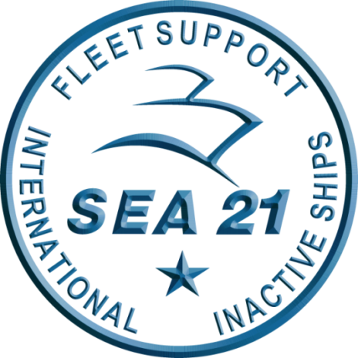


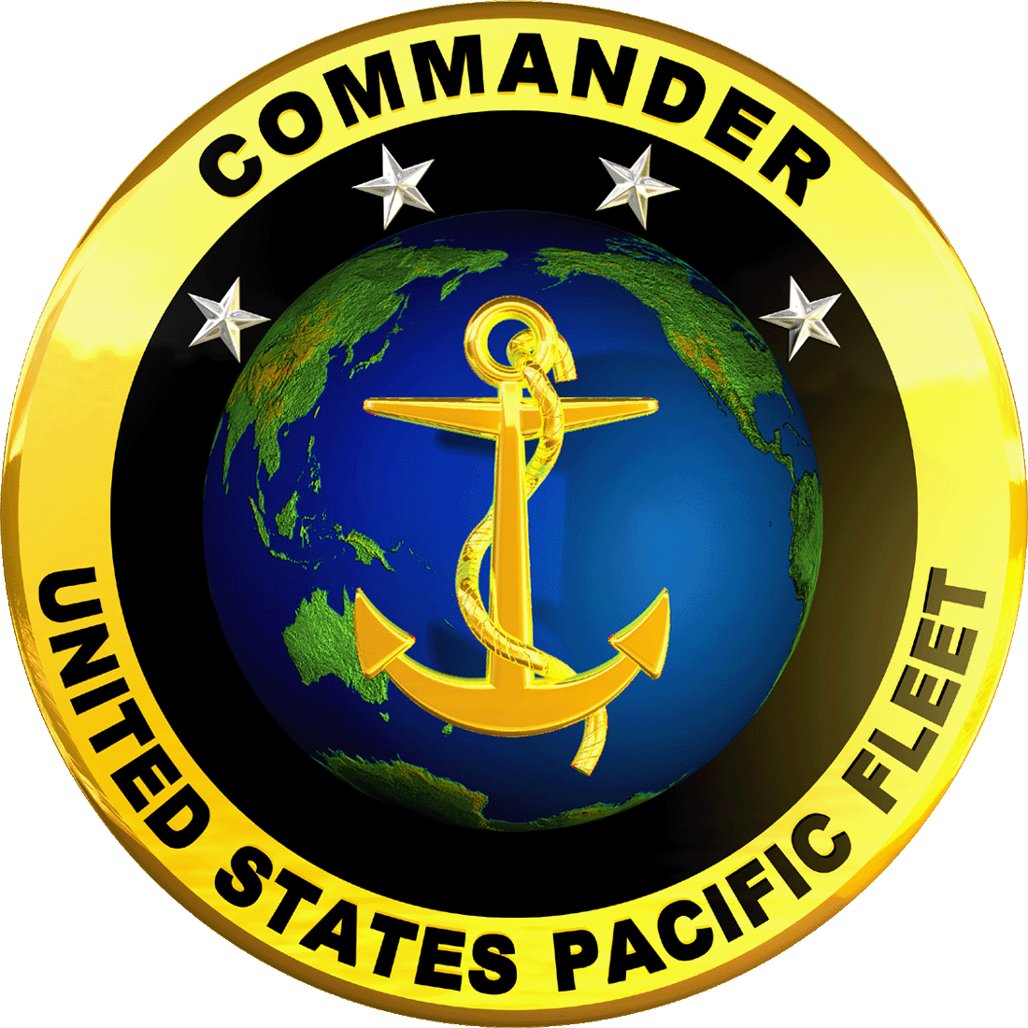
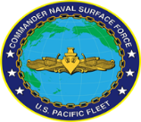

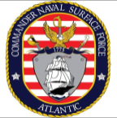

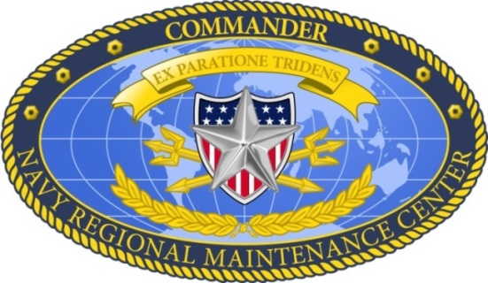
Building the PSI & PSO Roadmap –
Private Sector Improvements & Optimization
2018
Private Sector Improvement (PSI) Initiatives
January 2018
February 2018
March 2018
April 2018
May 2018………July 2018……….Sep 2018
2019
2020
SEA21 Brief SECNAV
Aqn Strategy
31 July
NAVSEA Brief ASN, RD&A
Aqn Strategy
02 August
PSO CONUS Infrastructure
Report to NAVSEA & POM-21 input
12/15
SEA 00 Guidance to RMC COs
6 Feb
FMMS/INDP
17-20 Sep,
Va Beach
Solicit NSI inputs
Gvt-Ind DD WG
Wargame Week
1-2 May San Diego
RFI Posted – PSI recommendations
15 Feb
Gvt-Ind PSI Wargame Week
Acq Strategy & Dry Dock Teams
6-9 Mar
Commence Near-Term Acq Strategy Implementation
Business Process Council
22-24 May, DC
Long Term Acq Strategy Implementation
Lead Ships ID for Change Management LOE
Business Process
Council, Dec, DC
PSO Infrastructure Plan Execute & Report
DD Working Group
formed,
weekly
drumbeat start
31 Jan
MegaRust
22-24 May
San Diego
Today
ASN, RD&A
Aqn Strategy Update Brief
13 September
SEA 00 Guidance shared with Industry
14 Feb
RFI Inputs rcvd
5 Mar
Private Sector
Optimization (PSO) Study
Scoping & Initial Staffing
Apr-May
Mid-Term Acq Strategy
Implementation
Complete Acq Strategy War Gaming – Way-Ahead decisions
PSO Study Execution Starts
June
SSRAC, Newport News VA
31 July – 3 August
PSI-ASIT Team formed. Weekly drumbeat start 1 Feb
Engineering Support Desks (ESD) established
SNA PSI Discussions w/ Industry
9-10 Jan
NSRIC – Maintenance Summit – PSI Industry Day
22 Mar
Contracts Governance Council,
Little Creek, VA
July 10-12
Notes:
Both PSI and PSO have been ongoing since the beginning of the year
As I said PSI grew our of a study announced at SNA
We held an off-site early in the year where the actions from the study were reviewed, appropriate ones taken for action, and grouped within LOE
We also stood up the dry dock working group and acquisition strategy improvement team to attack actions
A lot of input has come from industry so a goal has been to engage with industry all along. SNA, National Ship Repair Industry Conference (NSRIC), Mega Rust, FMMS, Contract Governance Council
WRT to PSO, after we stood the team up we had a flag/industry kickoff in June announce the plan and get buy in.
Going forward our efforts are implementing changes and the acquisition strategy

Slide 7
Purpose & Mission
Private Sector Optimization Plan
Evaluate Capability & Capacity:
  Private Sector (non-nuclear) Industrial Base
  RMC Contractual Oversight, Intermediate Maintenance, Technical
  Infrastructure & Logistics needed for Maintenance & Modernization
  Needs for future 355-ship Navy and/or FY50
Propose Actions/ COAs:
  Private Sector (non-nuclear) Industrial Base “As-Is” to “To-Be”
  RMC Contractual Oversight, Intermediate Maintenance, Technical “As-Is” to “To-Be”
  Infrastructure: Dry Docks, Optimization of Facilities, Capital Equipment
COAs Must Optimize Performance against (ROMs):
  Cost
  Schedule
  Quality
  Safety
  Surge Capacity
  Response Time
  Competition
  Organic (Navy) vs. Industry balance
  Other
Notes:
PSO methodology is to assess
What is our capacity now
What do we need for the 355 ship Navy
What are the Gaps
Recommend COAs to close the gaps
The PSO team has visited all fleet concentration areas
Met with all complex and non complex MAC holders
All bases
Sent out RFI
Dry docks
Government furnished equipment

Slide 8
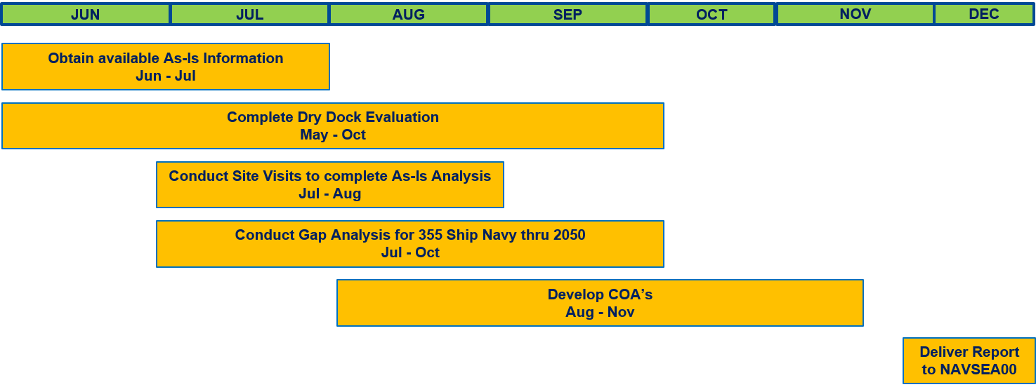
PSO: Take-Aways
  Dry Docks:
  Dry Dock Modeling:
      “As-Is” Notional Schedule
      Coastwide
      Increased Capacity
      Improved Process/Duration
  No single model “solves” all dry dock needs – will require a comprehensive approach.
  Will provide specific dock size recommendations (and FY timing) for each region
  Facilities/Optimization:
  Need to consolidate RMC facilities
  NAVSTA piers aged/lack maintenance capabilities
  Inadequate KTR pier space for pierside availabilities in some region(s)
  Champion existing NAVSTA projects to leverage maintenance needs and overall NAVSTA flexibility
  Capital Equipment:
  Lists provided by companies and RMCs
  9 responses to government RFI
  Remaining Timeline:
  Draft complete: 02NOV
  Industry Quick-Look: Week of 05NOV
    Company related info only
    SRA reps regional review
  RMC/NAVSTA Quick-Look: Week of 05NOV
  CNRMC Review: 16NOV
  Deliver to NAVSEA00: 14DEC
Notes:
Where do we stand
‘as is in complete’
We have made assumptions with SLEP, 30 Year shipbuilding plan, SLD to determine the requirements
Received answers back for Dry Dock and government furnished equipment RFI
Determining COAs now, examples of items we are considering
Construction at RMC to support better work force optimization
Base policy changes to support maintenance (maintenance piers, contractor laydown areas, efficient base access)
2 NOV draft complete for quick look to industry and SRA 5 NOV
Mid December submit the report to NAVSEA

Slide 9
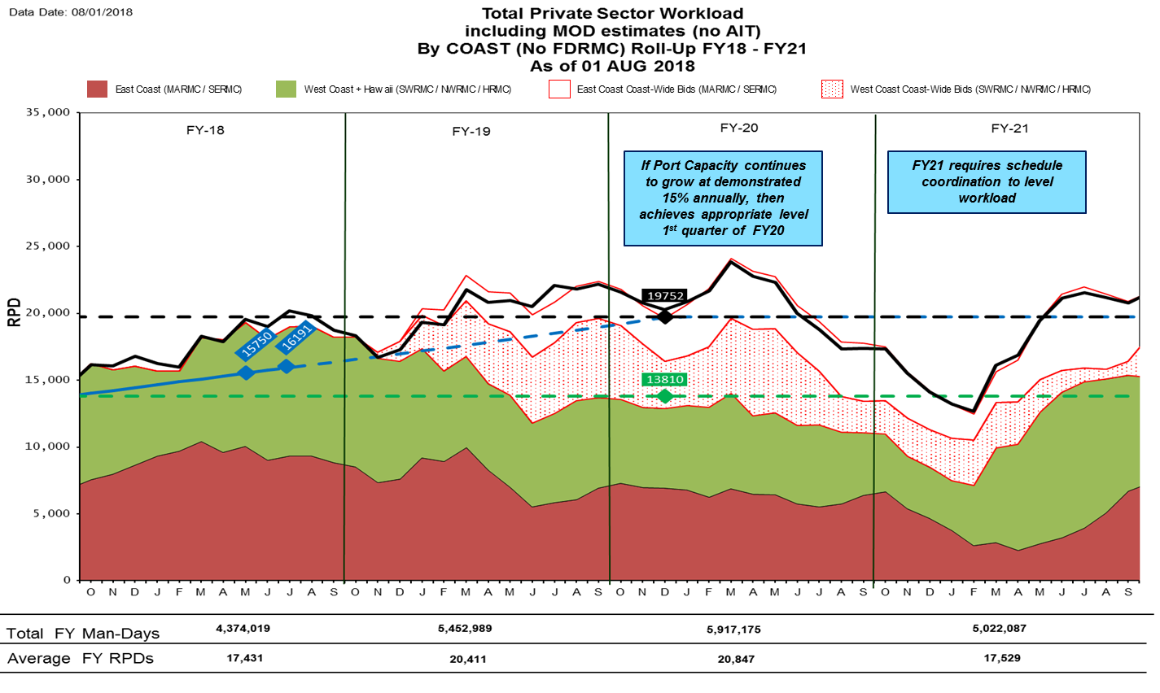
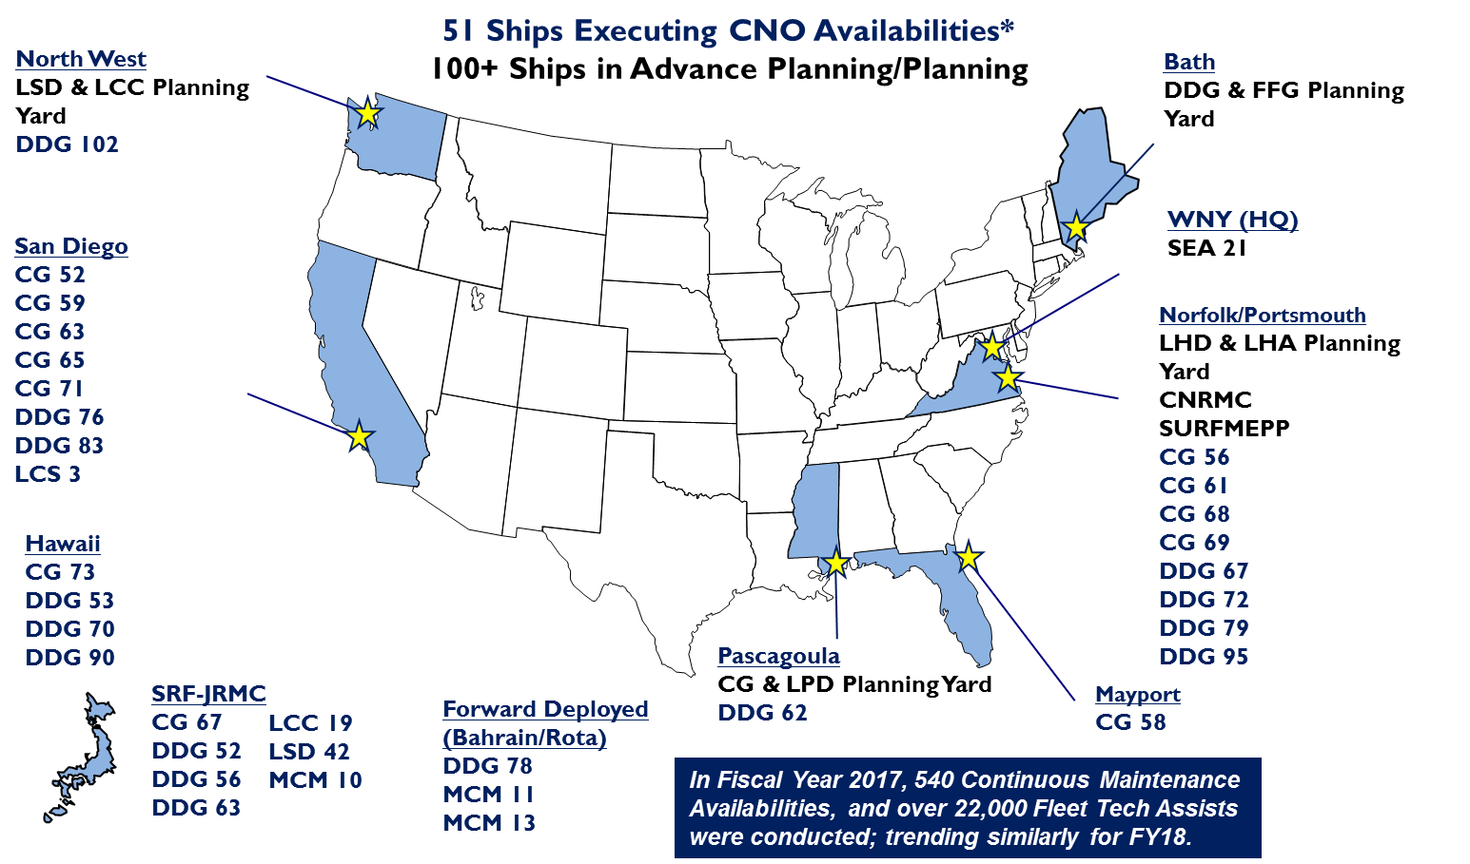
PSI Accomplishments & Actions
Industrial Base Health & Workload Stability
  Integrated PSA Workload impacts w/ POM20 “execute-ability” models
  NAVSEA “SLEP” Study providing initial input to PSO “Plan for 355”
  Developed & Refining “Actual vs. Planned” CNO Availability Manning measures to evaluate Industry capacity demand response
  FMMS/INDP completed 20 September
  Aligning PSO with 30 Year Ship Maintenance & Modernization Plan
Notes:
LOE 1
Must indicate workload to industry so they can grow
Also so the government can monitor port loading
Goal: stable and predictable (for government and industry)
We have expanded the scope to capture demands on ship repair industrial base
PSA, NECC, CMAVs, CVN
We are measuring KTR manning capacity as they report in the IPS weekly report. Determining if base is growing
Link with work of 30 year maintenance and mod plan
We are also sharing
Quarterly report to Congress
Release to industry
Quarterly industry engagement (FMMS)

Slide 10
PSI Accomplishments & Actions
Contracting & Contract Governance
  Contracts Governance Council (CGC) (Gvt-Industry) completed 10-12 July
  Pre-Solicitation Planning Support: Draft Plan under development
  Vertical Availability Grouping (double-dock): ARLEIGH BURKE (DDG 51)/ BULKELEY (DDG 84)/ GUNSTON HALL (LSD 44) – RFP posted. 32 day Industry requested proposal extension granted. Target Award Q1FY19
    FY19 Grouping scenarios in development
  Earlier Award: POAM rcvd 8 June, evaluated during CGC: Lead ship SHOUP (DDG 86), A-120 award, Nov ‘18
  Value Adjusted Trade-Off vs. LPTA: Lead Ships (FY19 Availabilities): ARLEIGH BURKE (DDG 51)/ BULKELEY (DDG 84)/GUNSTON HALL (LSD 44) - MARMC - and SHOUP (DDG 86) - NWRMC
  Acquisition Strategy Update Brief to SECNAV completed 31 July
  Acquisition Strategy Update Brief to ASN, RD&A completed 02 August
  Acquisition Strategy Update Brief to ASN, RDA completed 13 September
  Announced Fleet Maintenance & Modernization Summit (FMMS) Industry Navy Discussion Panel (INDP) completed 20 September ’18
  Horizontal Availability Grouping: Initial review completed 21 June. Further evaluation in progress. (Target FY20 Availabilities)
Notes:
LOE 2 focuses on changes to contracting and covers a big part of the acquisition strategy changes
Led by C400 through the ASIT
A lot of work in this LOE
CGC first in three years to review changes to Acquisition strategy
Bring industry into planning (drafted a plan, need to solicit)
Big hitters were are working
Earlier award. USS SHOUP at A-120
Vertically bundling (first RFPs out for BUL, ARB, GUN)
Moving toward quarterly solicitation
Value adjusted trade off
As we implement the proposed changes that have been brief to leadership, next challenge is horizontal bundling, awarding avails that cross FY

Slide 11
PSI Accomplishments & Actions
Streamlining Change Management & Oversight
  Contract Change Management Initiative
    LOE to Completion CLIN (Phase 1)
      Lead Ships: SAN DIEGO (LPD 22) - SWRMC - March ‘18 Award, 29 May ‘18 Start / HIGGINS (DDG 76) - SWRMC - July ‘18 Award, 05 November Start / MONTEREY (CG 61) – MARMC - July ‘18 Award, 10 September ‘18 Start
      Included in all new CNO RFPs moving forward
      Approval received from ASN (FMC), ASN (FMB), ASN (FMP) – 29 June ’18
      Currently included on 28 different CNO Avails in solicitation and/or execution, 22 cross fiscal years
    Small Dollar Value Change (Phase 2)
      Lead Ships: SHOUP (DDG 86); O’KANE (DDG 77); ARLEIGH BURKE (DDG 51)/ BULKELEY (DDG 84)/ GUNSTON HALL (LSD 44)
      Included in all new CWB RFPs moving forward
      Currently included on 8 different CNO Avails in solicitation
    Contract Change Management Joint Policy Memo – In final review for signature: ECD – Oct ‘18
    “Roadshow”/VTC scheduling in progress
Notes:
LOE 3 has seen a lot of progress
LOE to Completion CLIN funds growth up front at the CLIN
Anticipate quicker RCC cycle time (admin only RCC, work continues)
Will reduce UPWARD Ops
First ship is SAN Diego
Currently in 28 packages (22 cross FY)
SDVC
Expect to drastically lower RCC cycle time
Will impact major if RCC
In FITZ avail
IN 8 solicitations
Signing Joint Memo to codify process
Road show to RMCs to get all RMCs aligned

Slide 12
PSI Accomplishments & Actions
Streamlining Change Management & Oversight – Contract Change Management Results
  Near-term (FY19) results to measure for impact of “LOE to Completion CLIN” & “Small Dollar Value Change”:
    RCCs required:
      MEASURE – RCC counts on FY18/FY19 avails with changes implemented vs. historical RCC requirements
    RCC & CFR Cycle time:
      MEASURE – RCC cycle time on FY18/19 avails with changes implemented vs. historical RCC cycle times
      MEASURE – CFR response cycle times on FY18/19 avail with changes implemented vs. historical CFR response cycle times
    Upward Obligations (UPOBS) packages submitted & delays:
      MEASURE - # UPOBS packages submitted in FY18 (FY17 avails) vs. FY19 (FY18 avails)
      MEASURE – UPOBS approval delay time for packages submitted in FY18 (FY17 avails) vs. packages submitted in FY19 (FY18 avails)
Notes:
Next phase is to measure success
Our metrics we will use are RCC counts, cycle time, and upward ops

Slide 13
PSI Accomplishments & Actions
Streamlining Change Management & Oversight (cont.)
  NAVSEA Standard Items (NSIs)
    Industry proposed changes to 97 of 116 NSIs
    Completed 113 of 116 (97%) NSI Reviews
    283 of 287 proposed changes addressed (99%)
    4 changes to FY19 NSIs promulgated
    Results
      Eliminated 13 NSIs (11%)
      Eliminated 22 Required Reports (CFRs)
      Eliminated 26 Checkpoints (Total 30% reduction to date)
      Changed 4 NSIs from CAT I to CAT II (CAT I : invoked on all contracts – CAT II : invoked based on work performed)
    4 NSI changes evaluated at SSRAC (3 August) – 2 resolved, 2 with CNRMC for final adjudication
Notes:
Another major achievement is NSI review and streamlining
We worked with industry for inputs
Criteria: reduce schedule time and/or cost
Great feedback, initially resolved all but work four of the changes, 2 remaining after this summer’s Standard Specifications for Ship Repair and Alteration Committee (SSRAC)
Big take away is elimination of 17% of check points of NSI but the impact will be 30% overall reduction in checkpoints in avails because NSI are invoked so often

Slide 14
PSI Accomplishments & Actions
Streamlining Change Management & Oversight (Cont.)
  Checkpoint Reduction Initiative
    POAM developed with Industry (completed 10 May)
    Through NSI review & SSRAC, completed total 30% reduction in checkpoints (I/V/G)
    NSI Checkpoint Changes incorporated into FY19 CH4 (Posted 8/31)
    Master Spec Catalogue system-by-system checkpoint review with industry has begun. Standard Work Templates for main shafting, associated bearings and propellers have been passed to industry for review.
    Pilot availability approach and identification of pilot ships is in progress. (ECD October ‘18)
  Engineering Support Desk (ESD)
    All RMCs ESDs stood up
    Incorporate standard RMC/Industry execution & awareness
    Track Engineering Service Request (ESR) closure time as measure of effectiveness (in development)
  Standardize Process Control Procedures (PCPs)
    DRAFT CNRMC Instruction -Technical Control Procedure (TCP) –. CNRMC Instruction in draft. ECD 09 November for final RMC review.
    Identification of electronic storage location – NMD Reference Library designated
Notes:
Check point reduction to 50% is the next challenge
NSI check points gets us to 30%
Now revenging Master Spec Catalog, 1000s of check points
We will pilot on a ship
Engineering Support Desk seeks to lower RCC/change time by bring technical decision makers to the yard
This has happened, we are using and making teams aware of and how to use
PCP: Instead of paying the ktr to writing same PCP over and over, we are going to have standard TCP
Instruction and first one for diesel out to RMC for review

Slide 15
PSI Accomplishments & Actions
Streamlining Change Management & Oversight – Engineering Change Management Results
  Near term (FY19) results for Checkpoint reduction initiatives
    MEASURE - # Checkpoints scheduled (FY19 avails) vs. # Checkpoints scheduled (historical)
  Near term (FY19) results on Engineering Support Desk (ESD) implementation
    MEASURE – Engineering Support Request (ESR) cycle time (FY18/19 avails since ESD implemented) vs. historical ESR cycle times
Notes:
These are out measures of effectiveness
Check point count
ESR cycle time

Slide 16
PSI Accomplishments & Actions
Optimizing Availability Execution
  WASP Lessons Learned
    Incorporated in all LHA/D avail planning, provided for other ship classes
      Improved IPTD
    Growth Management
    Engineering Support Desk
  Joint RMC-IND “Tabletops” – Critical/Controlling Path
    NWRMC Lead Ship: KIDD (DDG 100) –9 March Start, Follow: SAMPSON (DDG 102) 16 July Start
    MARMC Lead Ships: GUNSTON HALL (LSD 44)/ARLEIGH BURKE (DDG 51)/ BULKELEY (DDG 84) (MARMC) – Observed NWRMC SAMPSON Tabletop 26 June
    SWRMC: Lead ship identification in progress
  Readiness-to-Start Criteria
    CNRMC RTS Instruction revision to reflect formal brief rqmt (ECD 01 Dec – Post BULKELEY/ ARLEIGH BURKE/ GUNSTON HALL Solicitation/Award/WPER)
      Exit Criteria for Work Package Execution Review
      Stacked Hands brief
Notes:
LOE 4 is focused on the Project Management
WASP lessons learned
Leaded boilers, IPTD soft skill development, early communication with all AIT, subs, etc (MSMO) and ships force
Implemented in all PT, codify in nect
Schedule Model Review
Week long event to bring in LMA, AIT, and subs to brief all work and LMA incrementally updates IPS
KIDD first ship on time completion
SAMPSON was 2nd
Part of solicitation for ARB/GUN/BUL
RTS
Formal exit criteria of WPER at A-30 so we enter avail eyes wide open
Early stacked hands brief to agree on work and risks

Slide 17
PSI Accomplishments & Actions
Optimizing Availability Execution (cont.)
  Dry-Dock Working Group (DDWG)
    DDWG meeting held 17 SEP 18 during FMMS. Bi-weekly working level PHONCONs held.
    Dock Certification/Recertification Process.
      RFI to identify additional dry dock resources. 11 inputs received 4 September. Review I/P (SEA 05 assisting).
    Reduce Dock Duration.
      Reduce OEM Requirement. CNRMC SME Guidance Issued.
      Reduce Technical Requirement.
        Shaft Work. Evaluating work sequencing and execution process improvements (Shafting Working Group (SWG)).
        Hull Painting. Evaluating Value Adjusted Tradeoff (VATO) options to NSI 009-32 using OEM paint warranties (Paint Working Group (PWG)).
        NEWCON vs Repair Specs. NAVSEA05 Study in I/P (POAM being developed).
        Gov’t/Industry SME (1on1) Meetings with drydock MSR to discuss painting, shafting and work sequencing. Vigor 25-28 Oct 2018.
      Capital Investments (Rotable Pools, Special Tooling Pools) – WGs being established.
        Shafting Rotable pool funding shifted from 2S to 7H cog (to NWCF). SWG working procurement plan with NAVSUP.
    Extend Docking Cycles.
      LCS Review in progress SEA05/PMS505.
        USS CORONADO (LCS 4) docking avail will evaluate feasibility to extending dry-dock periodicity for the LCS2 variant.
      Other Ship Classes. NAVSEA05 Study in I/P (POAM being developed).
Notes:
3rd DDWG meeting held at the beginning of FMMS
Goal is to use dock efficiently
Two working groups out of meeting
Paint Working Group to evaluate NSI government oversight vs. vendor warranty
Shaft RFI vs assess & repair
‘typical time’ for a ship class in the dock to ensure only work needed to be done in dock is done
RFI
Dry docks available
Government Furnished equipment
Lastly,
NAVSEA assessing technical requirement of LCS docking

Slide 18
PSI Accomplishments & Actions
Maintenance Governance
  GVT-IND PMT Team Building
    SCA Rep participation in ST1 ESC (11 June)
    Further ST1 participation by Industry (ESC/KSNs/CoPs)
      Capturing Carrier Team One best practices in gaining Industry participation, teambuilding
      NDA requirement for ST1 ESC.
      Working with 00L on guidance for Industry participation at MMPRs, KSNs, CoPs
  Recognition of Successful Projects
    Included on 26-28 June MMPR & all future MMPRs
    Identify common traits for successful Projects - capture “Must-Do” relevance
    Develop Project Management Team churn measure/feedback process
  Maintenance Team Training
    Updating WFD courses & IPTD events
    Make PT’s goal: Get to “Yes”
Notes:
LOE 5 Seeks to build the industry/government team
Bringing industry into ST1
Shipbuilding Council of America participated in on ESC, but then had sign a NDA
BAE has participated in execution KSN
Celebrate our victories
KIDD in last MMPR
KSN LL take away what successful teams do vice problems
Lastly,
Changes we have made must be brought into CNRMCs WRD curriculum so going forward to inculcate our accomplishments into our teams

Slide 19
PSO & PSI Executive Summary
Progress Across all PSO & PSI Lines of Effort
  PSO “As-Is” Site Visits Completed, Results being compiled for “To-Be” analysis, on plan to deliver report to NAVSEA December 2018
  PSI
    Significant progress complete in workload prediction, streamlining change management, NSI reduction, IPTD process. Next, continue execution and measure results
    Continue the progress in contract governance, drydock working group, checkpoint reductions, teaming with industry
  Alignment with 30 Year Ship Maintenance & Modernization Plan
Notes:
In Summary
PSO is writing the report on glide slope for a draft 2 NOV
PSI has made a lot of progress, must measure results
Still PSI work to do
Lastly, we must align with SEA 21 30 year Ship Maint & Mod plan

Slide 20
Questions?

