Slide 1
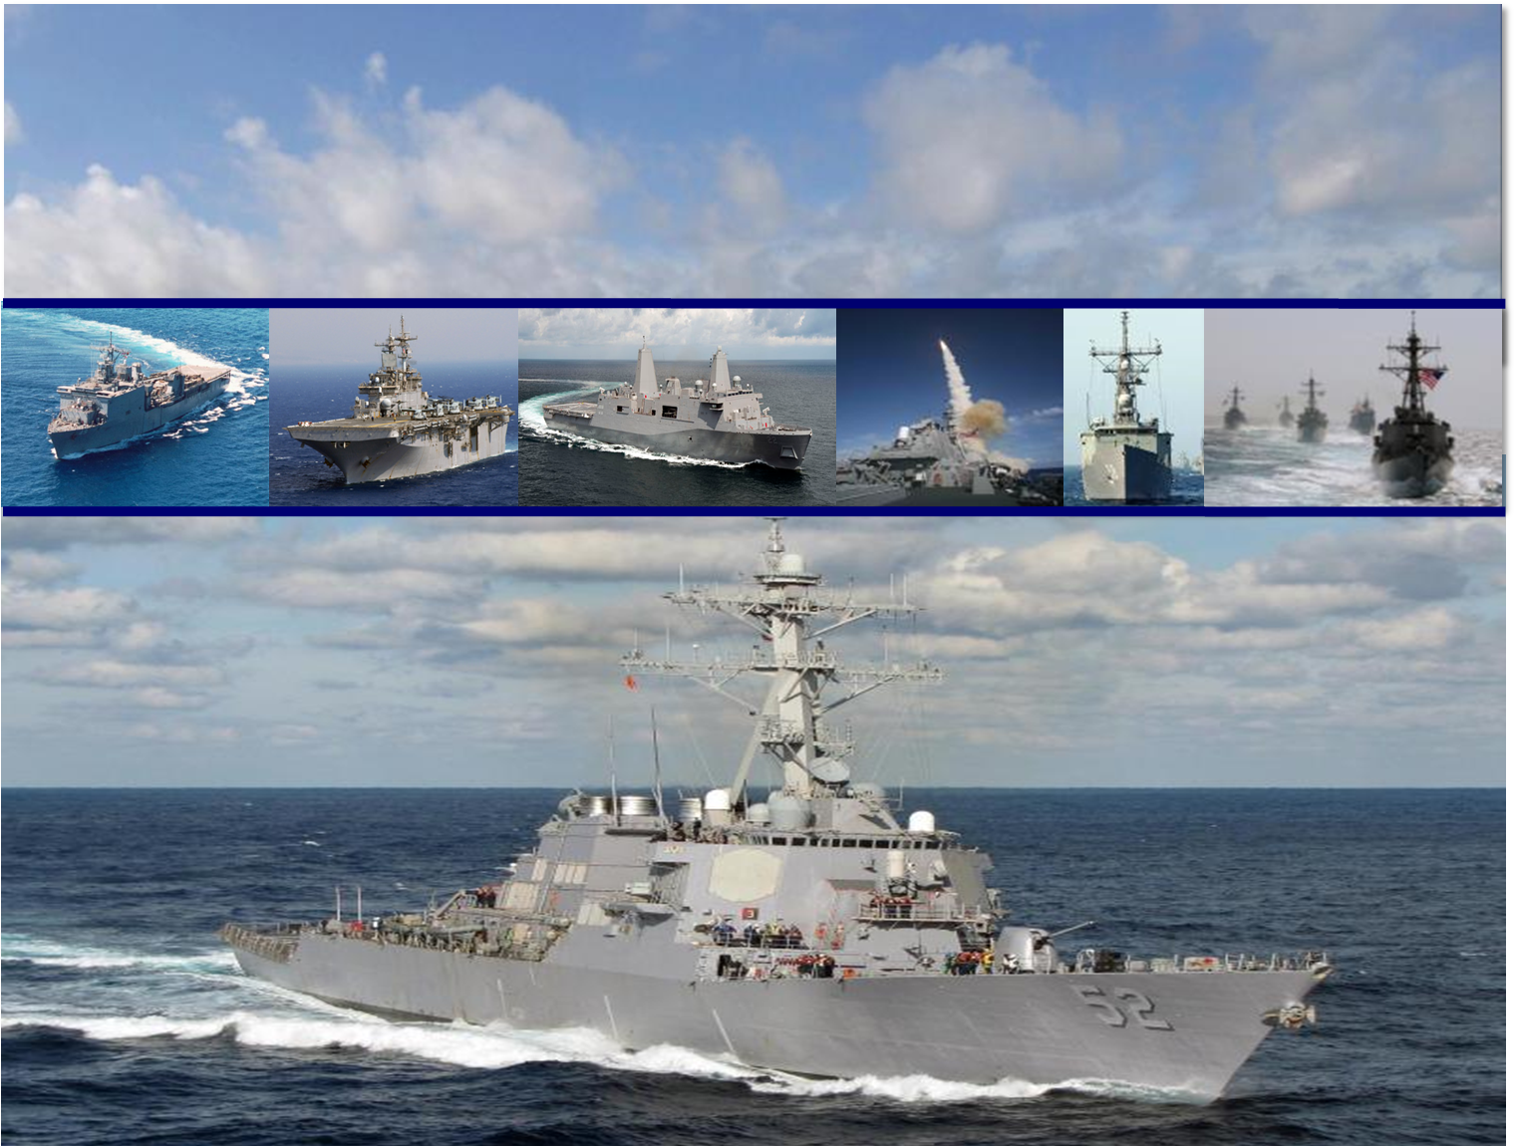
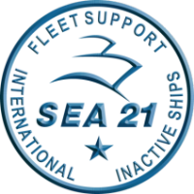
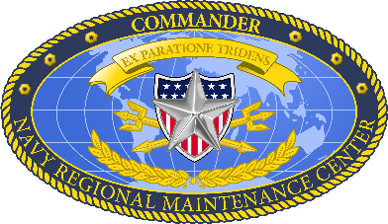
Industry Navy Discussion Panel
RDML Jim Downey
SEA 21/CNRMC
15 September 2016
UNCLASSIFIED
Distribution Statement A: Approved for Public Release. Distribution is unlimited

Slide 2
INDP Agenda
Time | Topic | Speaker | Objectives, Activities, Deliverables
0715-0730 | Seating | All Attendees | Seating
0730-0745 | Welcome/ Opening Remarks Communication with Industry | RDML Downey CAPT(sel) Neville Elyssa Parana | Objective: Welcome/Opening Remarks attendees Agenda review Potential CR Impact
0745-0830 | Commander’s Intent | RDML Downey | Objective: Commander’s intent
0830-0900 | Workload – Industrial Base stability | Tom Laverghetta | Objective: Workload Forecasting Update
0900-0915 | Break | All Attendees | Break
0915-1000 | Contract Strategy Update | CAPT(sel) Neville Paul Martindale Elyssa Parana | Objective: Quad Chart Overview Update on transition plan Current status of contracts awarded Non-Complex CMAV Contract Status Navy Addressing Solicitation consistency Solicit Industry Concerns
1000-1100 | Process Improvements | Ted Sanders Dale Davis | Objective: New Milestones Work Integration Quality Shipyard Access
1100-1130 | Questions | CAPT(sel) Neville | Objective: Questions
1130-1230 | Lunch

Slide 3
Leadership Changes/Guidance
Multiple leadership changes within the NAVSEA Surface Ship Stakeholder Community:
  COMNAVSEA
    VADM Moore relieved VADM Hilarides
  SEA04
    Ms. Smoot assumed duties from RADM Whitney
  SEA05
    RDML Selby relieved RADM Fuller
  SEA21/CNRMC
    RDML Downey relieved RDML Galinis
  PEO SHIPS
    RDML Galinis relieved RADM Gale
  PEO Carriers
    RADM Antonio relieved VADM Moore
  PEO LCS
    RADM Neagley relieved RADM Antonio
  NSWC
    RDML Druggan relieved RDML Selby
  PMS 407
    CAPT Byrne relieved CAPT Zobel
CNO Guidance
  Remain ready to meet current challenges, today
  Build a relevant and capable future force
  Enable and support our Sailors, Navy Civilians, and their Families
NAVSEA Commanders Intent/Priorities
  On-Time Delivery of Ships and Submarines
  Culture of Affordability
  Cybersecurity
SEA21/CNRMC Core Tenants/Priorities
  Availability Execution and Performance
  Fleet Sustainment
  Surface Ship Contracting Strategy
  CG and LSD Modernization Strategy
  LCS Sustainment & Maintenance

Slide 4
Executing Navy Priorities
CNO
ASN(RDA)
Strengthen Naval Power At And From The Sea
Achieve High Velocity Learning
Strengthen Our Navy Team for the Future
Expand And Strengthen our Network of Partners
Getting the Requirements Right
Making Every Dollar Count
Performing to Plan
Minding a Healthy Industrial Base
Strengthening Acquisition Workforce
COMNAVSEA
On-Time Delivery of Ships from Availabilities
Culture of Affordability
Cyber Security
SEA 21 /
CNRMC
Integrate maintenance strategies, modernization plans, training needs, and technical, logistics to best manage the lifecycle of surface ships

Slide 5
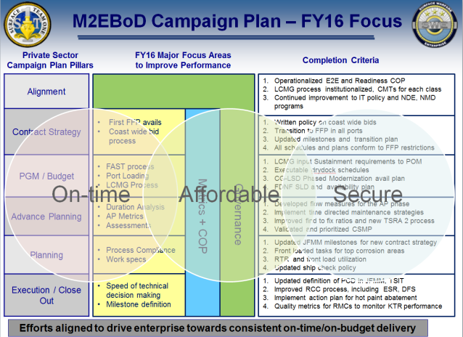
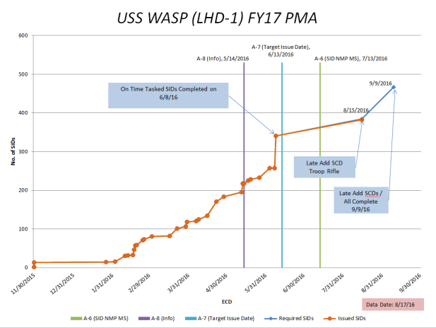
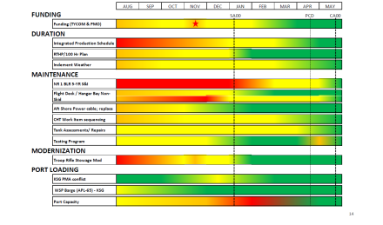
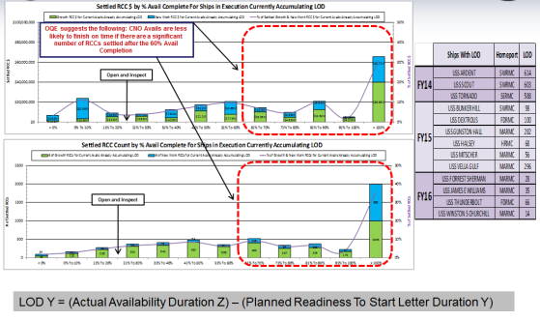
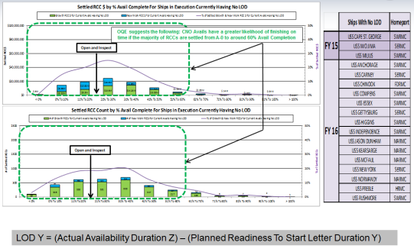
FOUO//BUSINESS SENSITIVE
On-Time Delivery of Ships
Balisle Report
RKC
Analysis
Surface Team 1
KSN POAM
CNSF Maintenance and Modernization Summit
Maintenance and Modernization Campaign Plan
Continually incorporates major actions and objectives identified at forums
Addresses Processes and Policies
Prioritizing Actions
Identify and Mitigate Risks = Drives Improved Schedule and Budget Adherence
Change Control
IT Infrastructure
Settled RCC Cost & Count For Ships
Common Focus Areas
NDE
NMD-R
ERP
Multiple Tools
Currently in Execution Accumulating LOD (Y)
Currently in Execution Having No LOD (Y)
OQE indicates CNO Avails less likely to finish on time if there are a significant number of Request for Contract Change (RCCs) settled after the 60% Avail Completion

Slide 6
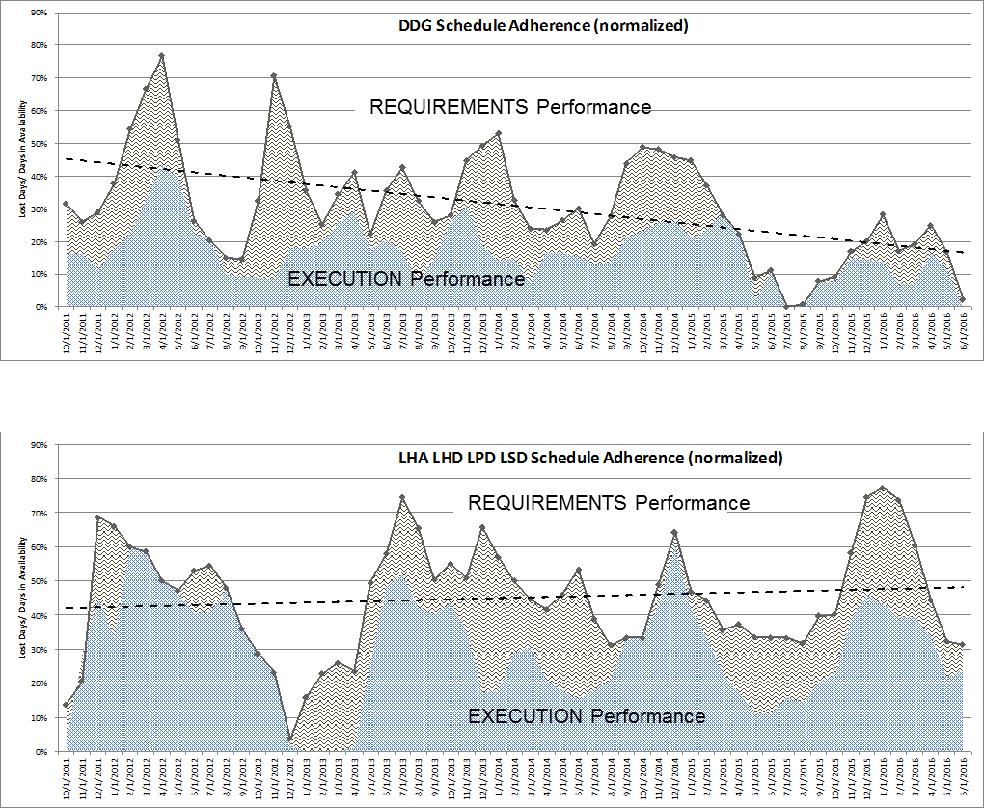
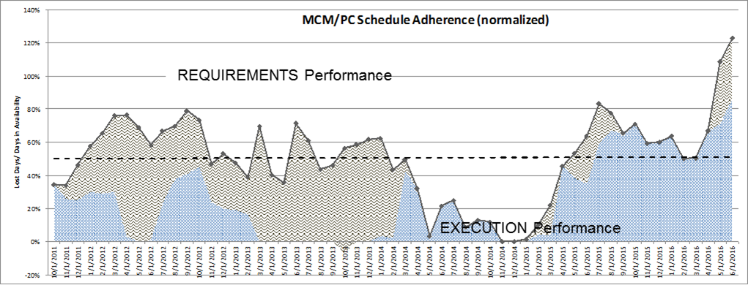
Schedule Performance
DDG Performance
Steady overall improvement driven by more accurate requirements and improving Avail Duration estimates
Amphib Performance
8% increase in schedule misses primarily due to tank growth (all classes), modernization and emergent repairs
Execution performance contributing approximately 50% of overall performance issues
MCM/PC Performance
MCM’s – MRG’s
PC’s – Hull Structure replacements
Execution performance

Slide 7
FY16 Takeaways (to date)
Policy updates include focus on best practices from prior years and milestone alignment with Acquisition Strategy update (FFP/3PP)
Change control process compliance reduces LOD
DDG schedule adherence trending positive; additional focus needed on other classes
Cost overall is trending positive
Routine senior industry engagement has been beneficial
MISSION PRIORITY NO. 1
On-Time Delivery of Ships and Submarines

Slide 8
Focus Areas
Predictable projection of work and stable strategy
On time, on budget delivery
  Defined and planned work
  Change control minimized and incorporated in contracts as early as possible
Work scope, schedule, and budgets aligned

Slide 9
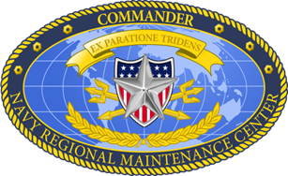
OTD of Ships and Submarines
FOUO//BUSINESS SENSITIVE
On-Time-Delivery is a “process of processes” with a cross-functional approach
FEEDBACK / INTERACTIONS
Interdependencies drive solutions sets through:
Planning
Contracting
Execution
On Time Delivery
INFRASTRUCTURE & INFORMATION TECHNOLOGY
HIGH VELOCITY LEARNING

Slide 10
NAVSEA Commander’s Intent
FOUO//BUSINESS SENSITIVE
RESOURCES
PLANNING
EXECUTION
CONTRACTING
Ensure Workload, capacities & funding in balance
Identify misalignment asap
Get requirements Right
Improve Duration forecasts including Growth and Emergent work
Upgrade Governance and process
Deliver 1st Time Quality
Improve Change Management
Reduce Execution Year Workload Churn
Establish executable, stable workload, well defined requirements and incentivize KTR performance
Develop more effective contracting strategies
Streamline contract award process
MATERIAL
INFRASTRUCTURE
/ IT
REQUIREMENTS
TECHNICAL
EXCELLENCE
Improve material forecasting
Optimize infrastructure investments
Replace, consolidate, and/or implement more effective IT tools and solutions
Eliminate/streamline specifications and requirements that add unnecessary time and cost
Exercise sound Engineering and Risk Management practices

Slide 11
Coast Wide Competitions Execution Contract Status
Time Now
 | RFP release
 | Source Selection
 | In Port Avail Execution
 | CW Port Avail Execution
/ To Be Competed

Slide 12
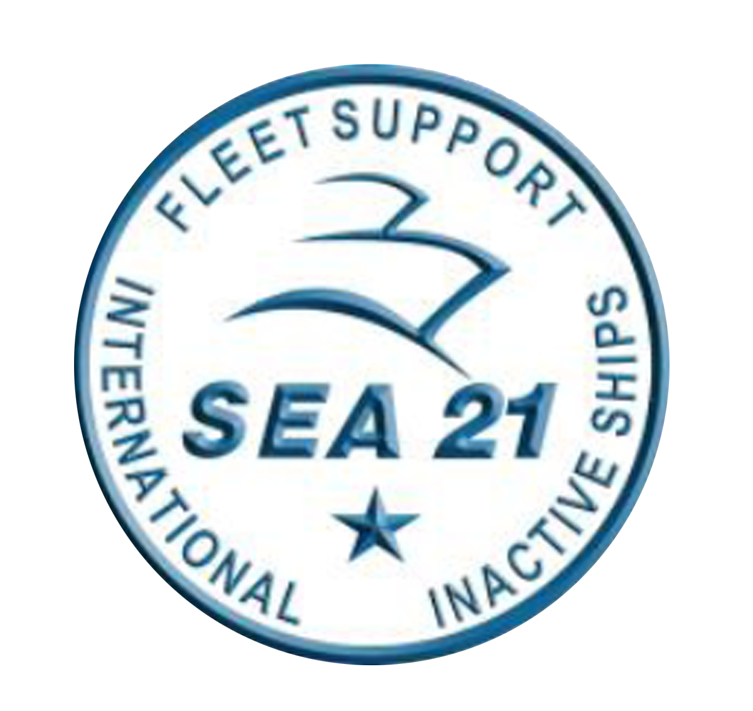
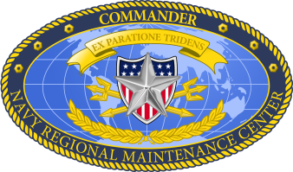
CNO Avail Milestones
IAW Acquisition Plan 14-021 signed by DASN (AP) on 8 APR 2015, the Navy’s strategy for Surface Ship Maintenance shifted from MSMO (Cost) to MACMO (FFP)
Process Map Event Held 9-13 May 2016 at CNRMC
  All Stakeholders in attendance
  New Milestones developed
    Coast-Wide Bids (Avails > 6 Months)
    MAC IDIQ (Avails < 6 Months)
Key Milestones
  Contract Determination Point (CDP) at A-540
    Will know if Coast-Wide Bid or Not
  100% lock at A-230 for Coast-Wide and A-170 for MAC-IDIQ
    Package lock earlier than under MSMO
  Contract Award at A-60
    Will know where Availability will be executed (Contractor and Location)
Disciplined planning is key to successful execution
  Timely work identification, brokering and prioritization
Key Events | Coast Wide | MAC IDIQ
CDP | A-540 | A-540
50% Lock | A-360 | A-305
80% Lock | A-285 | A-225
100% Lock | A-230 | A-170
WPIC | A-206 | A-145
Contract Award | A-60 | A-60
Notes:
The Navy has executed MSMO strategy since 2004. MSMOs scope include planning, execution, EM/CM, assessments, etc. Competitively awarded to one awardee on notional work package; Cost Type sole source environment for up to 5 years
Our New strategy is based on lessons learned from past and current contracting activities coupled with stakeholder and industry feedback. The new strategy implements a “family” of strategies recognizing the importance of port specific nuances to include volume, ship classes, and industrial capability. “One size does not fit all.”
The strategy will maximize competition and use of Fixed Price contracts to
Create enhanced competitive accountability for price, schedule & quality performance while maintaining flexibility and responsiveness.
Encourage work package discipline and effectively balance risk between the Navy and Industry.
We have briefed all our Navy Stakeholders, including our executive and legislative branches, and our Navy Fleet customers.
We have shared information and solicited feedback and input from industry through a series of communications to include:
Draft Statements Of Work (SOW) and Solicitations (to gain insight on Industry’s perception of our approach)
Draft Requests for Information & Sources Sought (to improve our understanding of the composition/capabilities of our Industrial base)
Industry Days (to maintain an open dialogue, answer questions and gain further insight into Industry’s outlook)
The Navy is NOT transitioning its entire portfolio all at once to a new strategy. The intention is to allow the continued use of our existing MSMOs until such time as a logical transition is in the best interest of the Government.

Slide 13
Coast-Wide Bid Way Ahead
Currently working to update policies and processes associated with coast-wide bids
  Advocating for revised statutory language that restricts availabilities of up to ten months to local bidding
    Period of performance defined as start of availability through dock trials
    Results in ~ 1/4 of east coast availabilities being subject to coast-wide bid
      18 of 70 planned availabilities (FY 17 - FY 20)
  NAVSEA/Fleet/TYCOM Working Group to:
    Review and validate crew entitlements associated with out-of-homeport award of availability contract (Home port shift, FSA, etc)
    Develop cost estimating guidance that fully accounts for all Navy costs of out-of-homeport award to ensure equitable evaluation of contractor proposals.
      Crew messing/berthing
      Crew entitlements (travel, FSA, PCS)
      Travel for ISIC/ATG/supporting orgs
      Availability management/support (project team, office facilities, barges)
    Develop “pre-planned responses” to provide the needed crew and project team support within the 60 day contract award window.
Notes:
The Navy has executed MSMO strategy since 2004. MSMOs scope include planning, execution, EM/CM, assessments, etc. Competitively awarded to one awardee on notional work package; Cost Type sole source environment for up to 5 years
Our New strategy is based on lessons learned from past and current contracting activities coupled with stakeholder and industry feedback. The new strategy implements a “family” of strategies recognizing the importance of port specific nuances to include volume, ship classes, and industrial capability. “One size does not fit all.”
The strategy will maximize competition and use of Fixed Price contracts to
Create enhanced competitive accountability for price, schedule & quality performance while maintaining flexibility and responsiveness.
Encourage work package discipline and effectively balance risk between the Navy and Industry.
We have briefed all our Navy Stakeholders, including our executive and legislative branches, and our Navy Fleet customers.
We have shared information and solicited feedback and input from industry through a series of communications to include:
Draft Statements Of Work (SOW) and Solicitations (to gain insight on Industry’s perception of our approach)
Draft Requests for Information & Sources Sought (to improve our understanding of the composition/capabilities of our Industrial base)
Industry Days (to maintain an open dialogue, answer questions and gain further insight into Industry’s outlook)
The Navy is NOT transitioning its entire portfolio all at once to a new strategy. The intention is to allow the continued use of our existing MSMOs until such time as a logical transition is in the best interest of the Government.

Slide 14
The Road to a Successful Avail
Know the condition of your ship
  Prioritize programs that promote material readiness – PMS/Zone Inspections/TSRA/RE
  Ensure CSMP is accurate and free of “underbrush”
  Ensure that jobs transmitted to shore file are comprehensive and accurate – they are the starting point for our work specifications
Insist on a proactive Maintenance Team
  Use PBFM to keep maintenance planning front and center; PE, PM and SMMO are key players
  Expect khaki to know the work package and planning milestone dates
  Ensure senior engagement at all IPTD events
  Daily meetings with PM/PE/SMMO in execution
Prepare ship to support Tagout and Work Control
  Train to Tagout and Work Control processes to ensure efficient work release and effective control of systems
  Ensure responsibilities, processes, and timelines for work control are clearly established
Closely control/manage work package change
  Initial work package accuracy/completeness helps minimize change and avoids costs & delays
  Closely manage change (RCC) process to ensure technical/funding decision delays do not endanger delivery
Be a demanding, engaged customer
  Insist on detailed weekly review of work accomplishment and critical path schedule
  Set and maintain high standards of cleanliness and safety; lays groundwork for effective work accomplishment
  Ensure ship’s force is independently tracking work progress
  Work as a team; provide forceful back-up/support to contractor and RMC
Notes:
The Navy has executed MSMO strategy since 2004. MSMOs scope include planning, execution, EM/CM, assessments, etc. Competitively awarded to one awardee on notional work package; Cost Type sole source environment for up to 5 years
Our New strategy is based on lessons learned from past and current contracting activities coupled with stakeholder and industry feedback. The new strategy implements a “family” of strategies recognizing the importance of port specific nuances to include volume, ship classes, and industrial capability. “One size does not fit all.”
The strategy will maximize competition and use of Fixed Price contracts to
Create enhanced competitive accountability for price, schedule & quality performance while maintaining flexibility and responsiveness.
Encourage work package discipline and effectively balance risk between the Navy and Industry.
We have briefed all our Navy Stakeholders, including our executive and legislative branches, and our Navy Fleet customers.
We have shared information and solicited feedback and input from industry through a series of communications to include:
Draft Statements Of Work (SOW) and Solicitations (to gain insight on Industry’s perception of our approach)
Draft Requests for Information & Sources Sought (to improve our understanding of the composition/capabilities of our Industrial base)
Industry Days (to maintain an open dialogue, answer questions and gain further insight into Industry’s outlook)
The Navy is NOT transitioning its entire portfolio all at once to a new strategy. The intention is to allow the continued use of our existing MSMOs until such time as a logical transition is in the best interest of the Government.

Slide 15
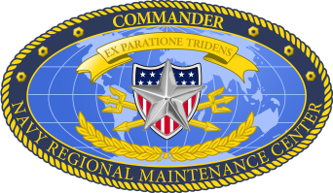
Coast Wide Competition Decision Policy
Statutory & Policy Requirements
10 USC 7299a – Construction of Combatant and Escort Vessels and Assignment of Vessel Projects (aka “Homeport Statute”)
Before issuing a solicitation for a contract for short-term work, defined as “work that will be for a period of six months or less”, for the overhaul, repair, or maintenance of a naval vessel, the Secretary of the Navy:
“Shall determine if there is adequate competition available among firms able to perform the work at the homeport of the vessel”. If there is adequate competition, Navy “shall issue such a solicitation only to firms able to perform the work at the homeport of the vessel”.
Currently, there is a legislative proposition in the FY-17 National Defense Authorization Act (NDAA) to change the definition of short-term work to “work that will be for a period of ten months or less”
SECNAV Ship Depot Maintenance Solicitation Policy – 16 June 1995 (aka “SECNAV Homeport Policy”)
All private sector ship depot level maintenance availabilities greater than six months in duration will be competed coast-wide unless the ASN(RDA) determines that competition is infeasible or special conditions exist.
Statute & Policy Implementation
SEA21 & SEA02 released joint policy on 11 May 2016 stating:
  The work period is defined as the period from the start of the availability to start of Dock Trials
  The work period, defined as the Contract Determination Point (CDP) shall be determined at A-540
Memo effective on Availabilities starting on 2 Nov 2017 to allow sufficient transition time for Availability planning.
  Contract Decision point milestone remains PCD for Availabilities starting prior to 2 Nov 2017
  Contract Decision point milestone transitions to Dock Trails for Availabilities starting after 2 Nov 2017
Currently, availabilities < 6 Months stay in homeport
Legislative Proposal in current NDAA to change to <10 Months
Notes:
The Navy has executed MSMO strategy since 2004. MSMOs scope include planning, execution, EM/CM, assessments, etc. Competitively awarded to one awardee on notional work package; Cost Type sole source environment for up to 5 years
Our New strategy is based on lessons learned from past and current contracting activities coupled with stakeholder and industry feedback. The new strategy implements a “family” of strategies recognizing the importance of port specific nuances to include volume, ship classes, and industrial capability. “One size does not fit all.”
The strategy will maximize competition and use of Fixed Price contracts to
Create enhanced competitive accountability for price, schedule & quality performance while maintaining flexibility and responsiveness.
Encourage work package discipline and effectively balance risk between the Navy and Industry.
We have briefed all our Navy Stakeholders, including our executive and legislative branches, and our Navy Fleet customers.
We have shared information and solicited feedback and input from industry through a series of communications to include:
Draft Statements Of Work (SOW) and Solicitations (to gain insight on Industry’s perception of our approach)
Draft Requests for Information & Sources Sought (to improve our understanding of the composition/capabilities of our Industrial base)
Industry Days (to maintain an open dialogue, answer questions and gain further insight into Industry’s outlook)
The Navy is NOT transitioning its entire portfolio all at once to a new strategy. The intention is to allow the continued use of our existing MSMOs until such time as a logical transition is in the best interest of the Government.

Slide 16
Capturing Costs –
Local vs Out-of-Homeport Avails
Current Policy Requirements
Current guidance, (Jaggard Memo) , signed 8 Feb 2000 includes the cost of:
Vessel & Berthing Barge Fuel Costs from home-port to place of performance and back
Vessel & Berthing Barge Towing & Pilot Charges out of home-port to place of performance and back
Type Commander Travel, (Includes PE, Type Desk Assistant, Immediate Supervisor, IMA, RMC)
Ship’s Force Travel, (IMA, Training 15% of Crew, 1 five day visit to Ship’s homeport)
SEA21 Revision of Schedule of Foreseeable Costs in progress. Costs under consideration include:
  TYCOM Representatives for Progress Conferences (2 persons, 3 two day visits)
  Long Term crew housing (beyond Berthing Barge Capacity)
  Off Ship Offices & Duty Section (beyond Berthing Barge Capacity)
  Family Separation Allowances
  Crew Transportation to homeport for family visits
  PCS costs
  Crew meal allowances
Legal Requirements. Foreseeable costs :
  Must reflect the ACTUAL differential between costs borne in homeport and costs borne out of port
  May not be speculative and conservative.
    The costs must be rooted in historical costs and Navy policy
    The costs must reflect the lowest possible outcome for each cost category, not averages or potential maximums.
Necessary for Equitable Evaluation of Proposals
Notes:
The Navy has executed MSMO strategy since 2004. MSMOs scope include planning, execution, EM/CM, assessments, etc. Competitively awarded to one awardee on notional work package; Cost Type sole source environment for up to 5 years
Our New strategy is based on lessons learned from past and current contracting activities coupled with stakeholder and industry feedback. The new strategy implements a “family” of strategies recognizing the importance of port specific nuances to include volume, ship classes, and industrial capability. “One size does not fit all.”
The strategy will maximize competition and use of Fixed Price contracts to
Create enhanced competitive accountability for price, schedule & quality performance while maintaining flexibility and responsiveness.
Encourage work package discipline and effectively balance risk between the Navy and Industry.
We have briefed all our Navy Stakeholders, including our executive and legislative branches, and our Navy Fleet customers.
We have shared information and solicited feedback and input from industry through a series of communications to include:
Draft Statements Of Work (SOW) and Solicitations (to gain insight on Industry’s perception of our approach)
Draft Requests for Information & Sources Sought (to improve our understanding of the composition/capabilities of our Industrial base)
Industry Days (to maintain an open dialogue, answer questions and gain further insight into Industry’s outlook)
The Navy is NOT transitioning its entire portfolio all at once to a new strategy. The intention is to allow the continued use of our existing MSMOs until such time as a logical transition is in the best interest of the Government.

Slide 17
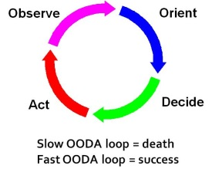
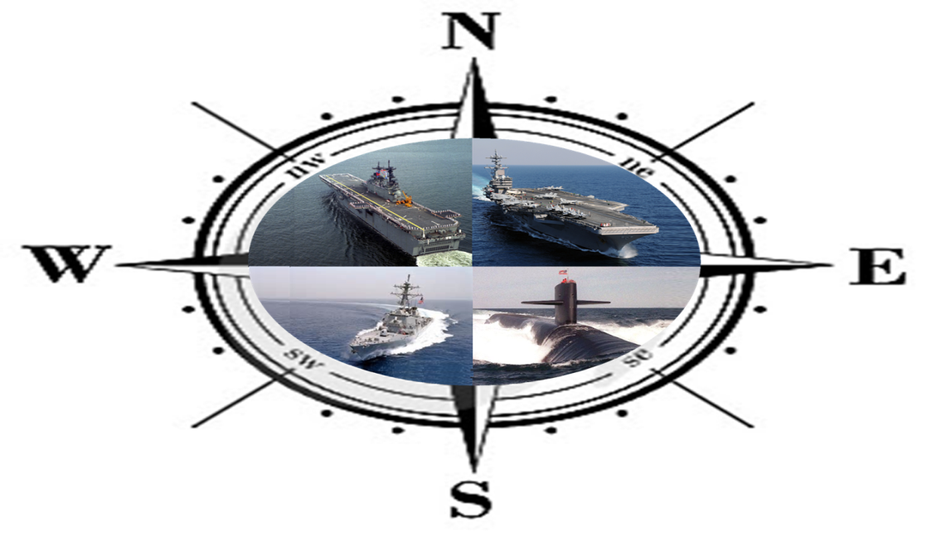
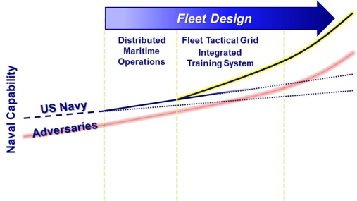

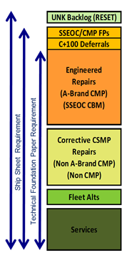
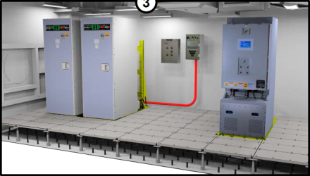
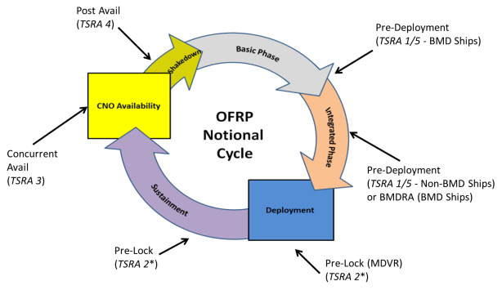
Fleet Maintenance and Modernization Symposium
Maintenance investments today that will provide enduring operational availability
Optimized Fleet Response Plan
High Velocity Learning
Modernization…
not just shining object… sustainable

Slide 18
Surface Ship Maintenance and Modernization Contracting Strategy
Industry-Navy Discussion Panel
September 15, 2016
Distribution Statement A: Approved for Public Release. Distribution is Unlimited

Slide 19
Surface Ship Maintenance, Repair, and Modernization Contracting Strategy
CNO Availabilities < 6 Months Production
CNO Availabilities > 6 Months Production
  Scope (Homeport Restricted)
  Docking & Non Docking CNO Availabilities < 6 months production
  Industrial Base
  Fully facilitized yards
  Contracting Approach & Qualifications Expected
  Complex MAC-IDIQ - FFP competitive Delivery Orders
  Expected Qualifications include:
    MSRA (or Equivalency), Waterfront Pier Facilities, and demonstrated capability to complete complex/CNO Availability level requirements
  Scope (Coast Wide)
  Docking & Non Docking CNO Availabilities > 6 months production
  Industrial Base
  Fully facilitized yards
  Contracting Approach
  Stand Alone Coast Wide Contracts - FFP competition
  Navy stakeholders reviewed Single Award IDIQ Stand Alone contract approach to adjudicate Industry & Government concerns and recommend implementing Coast Wide MAC-IDIQ
  Expected Qualifications include:
    MSRA (or Equivalency), Waterfront Pier Facilities, and demonstrated capability to complete complex/CNO Availability level requirements
Non Complex EM/CM (Small Business Set Aside)
Complex EM/CM
  Scope (Homeport Restricted)
  Emergent & Continuous Maintenance Availabilities, principally:
    Not expected to include work on Complex Systems
    Not expected to include large dollar value “Super” CMAVs
  Industrial Base
    Small businesses
  Contracting Approach & Qualifications Expected
  Non-Complex MAC-IDIQ - FFP sole source & competitive delivery orders
  Expected Qualifications include:
    High Level Management & Quality capability to successfully complete typical CMAV level requirements
  Scope (Homeport Restricted)
  Emergent & Continuous Maintenance Availabilities, principally:
    Includes work on Complex Systems
    Includes large dollar value “Super” CMAVs
  Industrial Base
  Fully facilitized yards
  Contracting Approach & Qualifications Expected
  Complex MAC-IDIQ -FFP & Cost, Sole source & competitive delivery orders
  Expected Qualifications include:
    MSRA (or Equivalency), Waterfront Pier Facilities, and demonstrated capability to complete complex/CNO Availability level requirements
Distribution Statement A: Approved for Public Release. Distribution is Unlimited

Slide 20
Coast Wide Availabilities
Time Now
 | RFP release
 | Source Selection
 | Avail Execution
Distribution Statement A: Approved for Public Release. Distribution is Unlimited

Slide 21
Homeport Availabilities
Norfolk Complex MAC
San Diego Complex MAC
Time Now
 | RFP release
 | Source Selection
 | Avail Execution
Distribution Statement A: Approved for Public Release. Distribution is Unlimited

Slide 22
Small Business Set Aside
Non-Complex MAC-IDIQ Contract Scope
  Non-Complex MAC-IDIQ scope includes:
  Continuous Maintenance (CM) and Emergent Maintenance (EM) ship availabilities (< 6 months production duration) on Surface Combatants (DDG/CG) and Amphibious Ships (LPD/LSD/LHA/LHD)
  Non Complex EM/CM requirements are not expected to include complex work on shipboard critical systems.
  However, complex requirements may also be procured under Non Complex MAC when doing so is in the best interest of the Government
  Complex MAC-IDIQ scope includes
  CNO Availabilities - Typically require a high degree of integration across critical and/or high growth systems
  Complex EM/CM including work on shipboard critical systems
  Non-complex requirements, including “Super CMAVs”, may be procured under Complex MAC-IDIQ when doing so is in the best interest of the Government
All Ship Class Critical Systems:
Main Reduction Gear (MRG)
Main Reduction Gear (MRG) L/O System
MRG Coupling / Clutches
Shafting and Bearing Systems
Steering Systems
LSD 41/49 & LPD 17 Class Critical Systems:
Main Propulsion Diesel Engine (MPDE)
MPDE Lube Oil System
MPDE Fuel Oil System
Ship Service Diesel Generator (SSDG)
SSDG Lube Oil System & Pedestal Bearings
SSDG Fuel Oil Systems
LPD17 Class Titanium Piping Systems Shipboard Central Hydraulics Systems
DDG-51/CG-47/LHD-8/LHA-6 Class Critical Systems:
Gas Turbine Module (GTM) Lube Oil
GTM Fuel Oil System
Gas Turbine Generator (GTG) Fuel Oil System
SSDG Engine (LHD-8/LHA-6 only)
SSDG Lube Oil Systems (LHD-8/LHA-6 only)
SSDG Fuel Oil Systems(LHD-8/LHA-6 only)
LPD-4/LHD-1/LHA-1-7 Class Critical Systems:
Main Boiler
HP/LP Turbines
Turbine LO Systems
SSTG / EDG Engines
Main Steam System (LVL1 material control)
Distribution Statement A: Approved for Public Release. Distribution is Unlimited
Notes:
Based Industry feedback and additional market research, the Navy has continued to refine its contracting approach.
Multiple Award IDIQ contracts
Each MAC contract awarded to at least 2 technically qualified Primes:
MACs support Competitive/Sole Source and Fixed Price/Cost type Delivery Orders (DO)
Individual DOs will be awarded based on actual work packages.
Availabilities will be competed as FFP DOs to the greatest extent practicable.
Urgent requirements may be directed on sole source cost type basis.
Multiple Award IDIQ contracts provide the best approach to maximize competition
Changes
Surface Combatant and Amphibious Ship Docking and Non-docking CNO availabilities (with less than six months production work) will be executed under the Multiple Award IDIQ contracts
Contract will have five year period of performance.
Navy intends to set-aside non-complex requirements for small businesses, in ports where two or more capable small businesses demonstrate interest

Slide 23
BACKUP
Notes:
The Navy has executed MSMO strategy since 2004. MSMOs scope include planning, execution, EM/CM, assessments, etc. Competitively awarded to one awardee on notional work package; Cost Type sole source environment for up to 5 years
Our New strategy is based on lessons learned from past and current contracting activities coupled with stakeholder and industry feedback. The new strategy implements a “family” of strategies recognizing the importance of port specific nuances to include volume, ship classes, and industrial capability. “One size does not fit all.”
The strategy will maximize competition and use of Fixed Price contracts to
Create enhanced competitive accountability for price, schedule & quality performance while maintaining flexibility and responsiveness.
Encourage work package discipline and effectively balance risk between the Navy and Industry.
We have briefed all our Navy Stakeholders, including our executive and legislative branches, and our Navy Fleet customers.
We have shared information and solicited feedback and input from industry through a series of communications to include:
Draft Statements Of Work (SOW) and Solicitations (to gain insight on Industry’s perception of our approach)
Draft Requests for Information & Sources Sought (to improve our understanding of the composition/capabilities of our Industrial base)
Industry Days (to maintain an open dialogue, answer questions and gain further insight into Industry’s outlook)
The Navy is NOT transitioning its entire portfolio all at once to a new strategy. The intention is to allow the continued use of our existing MSMOs until such time as a logical transition is in the best interest of the Government.

