Slide 1
Surface Ship Maintenance and Modernization Contracting Strategy
Industry-Navy Discussion Panel
September 15, 2016
Distribution Statement A: Approved for Public Release. Distribution is Unlimited

Slide 2
Industry Day Ground Rules
The purpose of this briefing is to continue our engagement with Industry on the Navy’s Non-Nuclear Surface Ship Maintenance, Repair & Modernization Execution Contracting Strategy.
The information provided represents the Navy’s intentions, but is not final and is therefore to be considered draft and entirely non-binding. This presentation does not constitute a Request for Proposal (RFP) nor a commitment on behalf of the Navy of any kind.
Questions related to the on-going source selections shall be directed to the contracting officer designated in Section L of the corresponding RFP.
Distribution Statement A: Approved for Public Release. Distribution is Unlimited

Slide 3
Surface Ship Maintenance, Repair, and Modernization Contracting Strategy
CNO Availabilities < 6 Months Production
CNO Availabilities > 6 Months Production
  Scope (Homeport Restricted)
  Docking & Non Docking CNO Availabilities < 6 months production
  Industrial Base
  Fully facilitized yards
  Contracting Approach & Qualifications Expected
  Complex MAC-IDIQ - FFP competitive Delivery Orders
  Expected Qualifications include:
    MSRA (or Equivalency), Waterfront Pier Facilities, and demonstrated capability to complete complex/CNO Availability level requirements
  Scope (Coast Wide)
  Docking & Non Docking CNO Availabilities > 6 months production
  Industrial Base
  Fully facilitized yards
  Contracting Approach
  Stand Alone Coast Wide Contracts - FFP competition
  Navy stakeholders reviewed Single Award IDIQ Stand Alone contract approach to adjudicate Industry & Government concerns and recommend implementing Coast Wide MAC-IDIQ
  Expected Qualifications include:
    MSRA (or Equivalency), Waterfront Pier Facilities, and demonstrated capability to complete complex/CNO Availability level requirements
Non Complex EM/CM (Small Business Set Aside)
Complex EM/CM
  Scope (Homeport Restricted)
  Emergent & Continuous Maintenance Availabilities, principally:
    Not expected to include work on Complex Systems
    Not expected to include large dollar value “Super” CMAVs
  Industrial Base
    Small businesses
  Contracting Approach & Qualifications Expected
  Non-Complex MAC-IDIQ - FFP sole source & competitive delivery orders
  Expected Qualifications include:
    High Level Management & Quality capability to successfully complete typical CMAV level requirements
  Scope (Homeport Restricted)
  Emergent & Continuous Maintenance Availabilities, principally:
    Includes work on Complex Systems
    Includes large dollar value “Super” CMAVs
  Industrial Base
  Fully facilitized yards
  Contracting Approach & Qualifications Expected
  Complex MAC-IDIQ -FFP & Cost, Sole source & competitive delivery orders
  Expected Qualifications include:
    MSRA (or Equivalency), Waterfront Pier Facilities, and demonstrated capability to complete complex/CNO Availability level requirements
Distribution Statement A: Approved for Public Release. Distribution is Unlimited

Slide 4
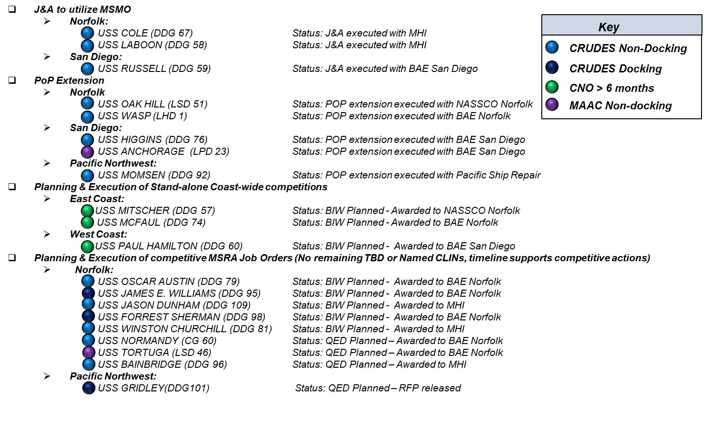
Transition Mitigation
Status: QED Planned - Awarded to Vigor
Distribution Statement A: Approved for Public Release. Distribution is Unlimited

Slide 5
Contract Strategy Execution Status
  3rd Party Planning Contract Status: All 3rd Party Planning Contracts have been awarded
  MAC-IDIQ Contract Status:
Milestone | DDG/CG | LSD/LPD | LHA/LHD
Award Date | AWARDED 2/09/2015 | AWARDED 5/27/2015 | AWARDED 4/27/2016
Planning Complete | 11 CNO Avails | 3 CNO Avails | 0 CNO Avails
First Avail | USS Normandy | USS New Orleans | USS Makin Island
First Avail Planning Begins | 2/12/2015 | 6/14/2015 | 5/2/2016
First Avail Begins | 2/23/2016 | 1/09/2017 | 8/07/2017
PORT | Contract | Anticipated RFP Release | Status
NORFOLK | Complex MAC-IDIQ | Jun-15 | Awarded
SAN DIEGO | Complex MAC-IDIQ | Dec-15 | Awarded
MAYPORT | MAC-IDIQ | Feb-16 | Proposal Evaluation
NORFOLK | Non-Complex MAC-IDIQ | 1st Qtr FY17 | Acquisition Planning
SAN DIEGO | Non-Complex MAC-IDIQ | 1st Qtr FY17 | Acquisition Planning
PACIFIC NORTHWEST | MAC-IDIQ | 2ND Qtr FY17 | Acquisition Planning
EAST COAST | MAC-IDIQ | 2ND Qtr FY17 | Acquisition Planning
WEST COAST | MAC-IDIQ | 2ND Qtr FY17 | Acquisition Planning
PEARL HARBOR | MAC-IDIQ | 2ND Qtr FY19 | Acquisition Planning
Distribution Statement A: Approved for Public Release. Distribution is Unlimited

Slide 6
Coast Wide Availabilities
Time Now
 | RFP release
 | Source Selection
 | Avail Execution
Distribution Statement A: Approved for Public Release. Distribution is Unlimited

Slide 7
Homeport Availabilities
Norfolk Complex MAC
San Diego Complex MAC
Time Now
 | RFP release
 | Source Selection
 | Avail Execution
Distribution Statement A: Approved for Public Release. Distribution is Unlimited

Slide 8
Questions
All participants are highly encouraged to ask questions related to topics presented today.
Please Introduce yourself by name and company prior to asking your question.
Questions related to the on-going source selections shall be directed to the contracting officer designated in Section L of the corresponding RFP.
Distribution Statement A: Approved for Public Release. Distribution is Unlimited

Slide 9
Back Up
Distribution Statement A: Approved for Public Release. Distribution is Unlimited

Slide 10
Small Business Set Aside
Non-Complex MAC-IDIQ Contract Scope
  Non-Complex MAC-IDIQ scope includes:
  Continuous Maintenance (CM) and Emergent Maintenance (EM) ship availabilities (< 6 months production duration) on Surface Combatants (DDG/CG) and Amphibious Ships (LPD/LSD/LHA/LHD)
  Non Complex EM/CM requirements are not expected to include complex work on shipboard critical systems.
  However, complex requirements may also be procured under Non Complex MAC when doing so is in the best interest of the Government
  Complex MAC-IDIQ scope includes
  CNO Availabilities - Typically require a high degree of integration across critical and/or high growth systems
  Complex EM/CM including work on shipboard critical systems
  Non-complex requirements, including “Super CMAVs”, may be procured under Complex MAC-IDIQ when doing so is in the best interest of the Government
All Ship Class Critical Systems:
Main Reduction Gear (MRG)
Main Reduction Gear (MRG) L/O System
MRG Coupling / Clutches
Shafting and Bearing Systems
Steering Systems
LSD 41/49 & LPD 17 Class Critical Systems:
Main Propulsion Diesel Engine (MPDE)
MPDE Lube Oil System
MPDE Fuel Oil System
Ship Service Diesel Generator (SSDG)
SSDG Lube Oil System & Pedestal Bearings
SSDG Fuel Oil Systems
LPD17 Class Titanium Piping Systems Shipboard Central Hydraulics Systems
DDG-51/CG-47/LHD-8/LHA-6 Class Critical Systems:
Gas Turbine Module (GTM) Lube Oil
GTM Fuel Oil System
Gas Turbine Generator (GTG) Fuel Oil System
SSDG Engine (LHD-8/LHA-6 only)
SSDG Lube Oil Systems (LHD-8/LHA-6 only)
SSDG Fuel Oil Systems(LHD-8/LHA-6 only)
LPD-4/LHD-1/LHA-1-7 Class Critical Systems:
Main Boiler
HP/LP Turbines
Turbine LO Systems
SSTG / EDG Engines
Main Steam System (LVL1 material control)
Distribution Statement A: Approved for Public Release. Distribution is Unlimited
Notes:
Based Industry feedback and additional market research, the Navy has continued to refine its contracting approach.
Multiple Award IDIQ contracts
Each MAC contract awarded to at least 2 technically qualified Primes:
MACs support Competitive/Sole Source and Fixed Price/Cost type Delivery Orders (DO)
Individual DOs will be awarded based on actual work packages.
Availabilities will be competed as FFP DOs to the greatest extent practicable.
Urgent requirements may be directed on sole source cost type basis.
Multiple Award IDIQ contracts provide the best approach to maximize competition
Changes
Surface Combatant and Amphibious Ship Docking and Non-docking CNO availabilities (with less than six months production work) will be executed under the Multiple Award IDIQ contracts
Contract will have five year period of performance.
Navy intends to set-aside non-complex requirements for small businesses, in ports where two or more capable small businesses demonstrate interest

