Slide 1
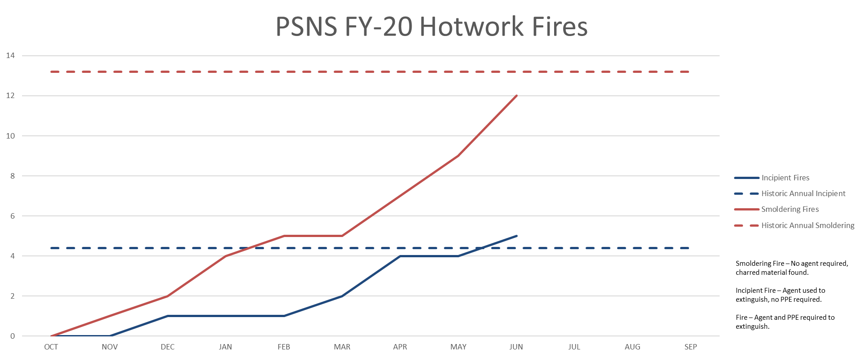
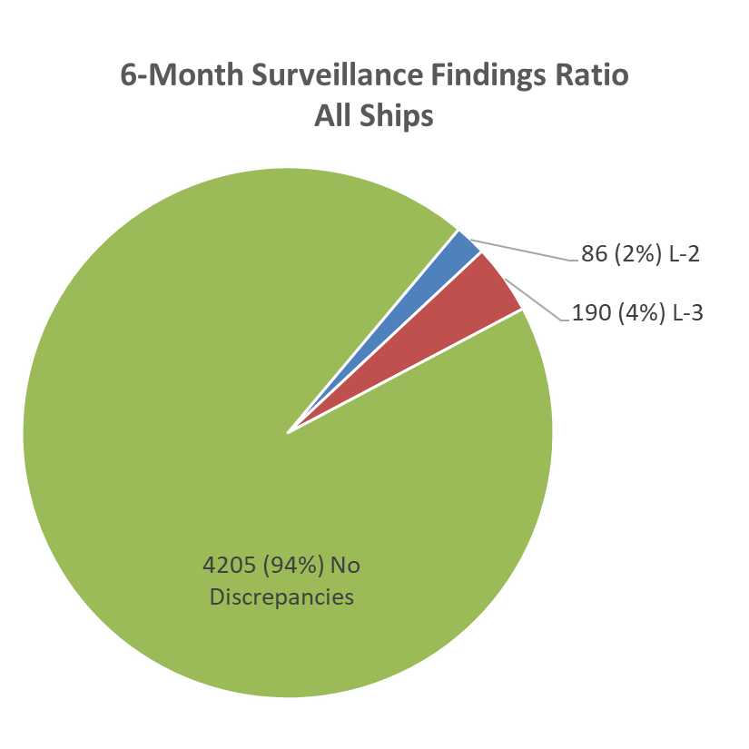
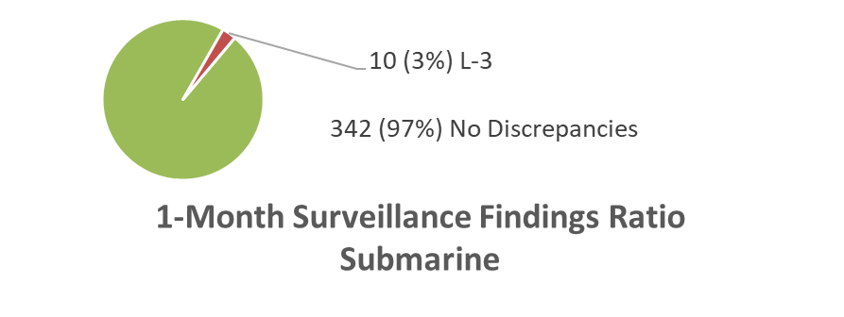
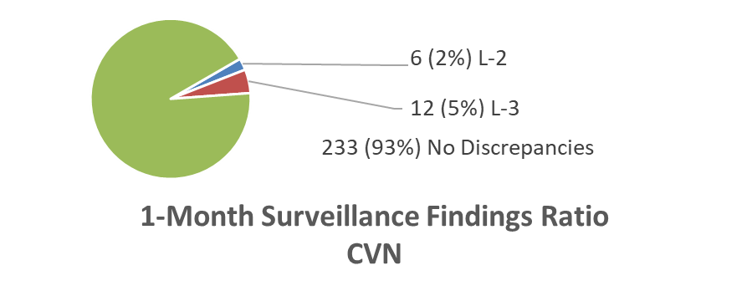
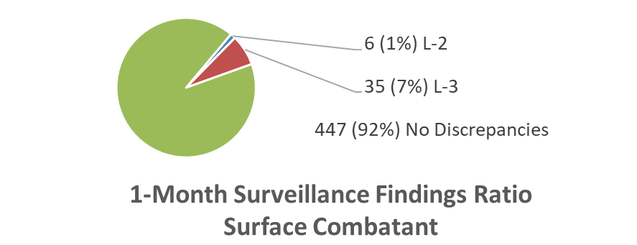
Hot Work Report For June 2020

Slide 2
Summary of Hot Work Fires for June
1) Workers conducted hot work on a tank overhead without authorization or backside mitigation. A fire watch from another space saw the smoking insulation and put it out.
2) Protection of plastic cleanliness containments continues to be a problem, a fire-proof shield is required. Plastic containments are later discovered to be burnt and/or melted.
3) Inadequate paint abatement; backside of hot work sites have charred paint.
Level 2 Hot Work findings summary
1) Hot work in progress without an authorized work permit.
2) Hot work in progress with a ‘not safe for hot work’ chit posted.
3) No fire extinguisher.
4) Containment insufficient and allowing hot work sparks/debris to escape the site and often fall on uncovered non fire-retardant material. (x2)
5) Fire watch reading a book.
6) Hot work site had an inadequate amount of fire watches.
Level 3 Hot Work findings/trends
1) Ventilation issues are on the rise, smoke/dust should not build up in the space or adjacent areas.
2) Containments, either not robust enough to protect a cleanliness boundary or failing to contain general work products. A containment that was adequate at the beginning of a shift may need to be rebuilt during work.
Fire watches. Current trends show fire watches are inattentive and failing to note or take action when the situation calls for
it, e.g. smoke filling the space / sparks falling outside containment.
For questions contact Code 304 Rich Gale @ (360) 551-6835

